Slide 1
FE – SEM-II-CBCS-C-SCHEME
FEC-201 , ENGINEERING MATHEMATICS -II

Slide 2
ENGINEERING MATHEMATICS -II
Syllabus – 6 Modules
Module 1 :Differential Equations of First Order and First Degree
1.2 Exact differential Equations, Equations reducible to exact form by using integrating factors. 1.2 Linear differential equations (Review), equation reducible to linear form, Bernoulli’s equation.
Module 2:Linear Differential Equations With Constant Coefficients and Variable Coefficients Of Higher Order
2.1. Linear Differential Equation with constant coefficient‐ complementary function, particular integrals of differential equation of the type f(D)y = X where X is 𝑒 𝑎𝑥 , sin(𝑎𝑥 + 𝑏) , cos (𝑎𝑥 + 𝑏), 𝑥 𝑛 , 𝑒 𝑎𝑥𝑉, 𝑥 𝑉. 2.2. Method of variation of parameters.

Slide 3
Module 3: Beta and Gamma Function, Differentiation under Integral sign and Rectification 3.1 Beta and Gamma functions and its properties. 3.2 Differentiation under integral sign with constant limits of integration. 3.3 Rectification of plane curves.(Cartesian and polar)
Module 4 : Multiple Integration-1
4.1. Double integration‐definition, Evaluation of Double Integrals.(Cartesian & Polar) 4.2. Evaluation of double integrals by changing the order of integration. 4.3. Evaluation of integrals over the given region.(Cartesian & Polar)
Module 5 : Multiple Integration-2
5.1. Evaluation of double integrals by changing to polar coordinates.
5.2. Application of double integrals to compute Area
5.3.Triple integration definition and evaluation (Cartesian, cylindrical and spherical polar coordinates).

Slide 4
Module 6 : Numerical solution of ordinary differential equations of first order and first degree, and , Numerical Integration
6.1. Numerical solution of ordinary differential equation using (a) Euler’s method (b) Modified Euler method, (c) Runge‐Kutta fourth order method
6.2. Numerical integration‐ by (a) Trapezoidal (b) Simpson’s 1/3rd (c) Simpson’s 3/8th rule (all with proof).

Slide 5
Test – 1,2 Assignments
TERM WORK – Tutorials
Theory + Test + Term Work = 80 + 20 +25 =125

Slide 6
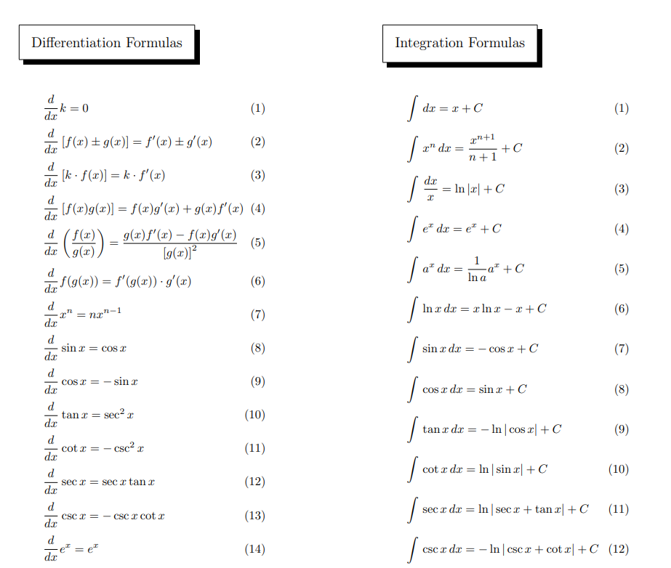
Formulae of derivative and integration

Slide 7
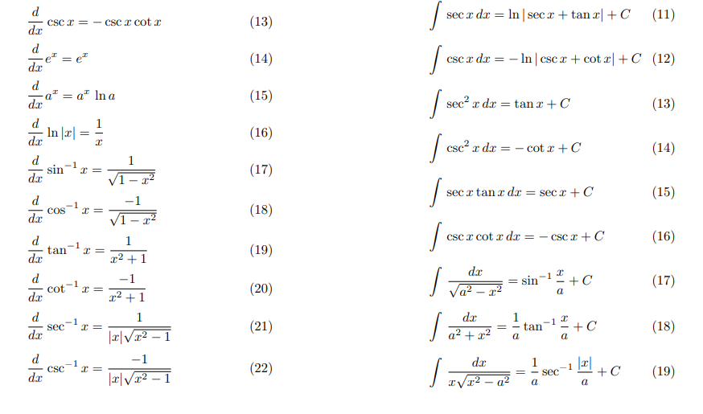

Slide 8
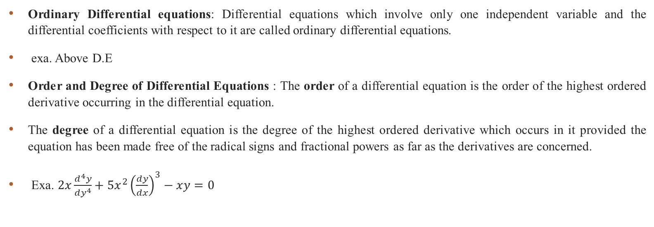

Differential Equations of First Order and First Degree A Differential equation is an equation involving differentials or differential coefficients. Exa. $\frac{dy}{dx}=\frac{y+1}{\left(y+2\right)e^{y}−x}$ , $2x\frac{d^{4}y}{dy^{4}}+5x^{2}{\left(\frac{dy}{dx}\right)}^{3}−xy=0$
Ordinary Differential equations: Differential equations which involve only one independent variable and the differential coefficients with respect to it are called ordinary differential equations.
exa. Above D.E
Order and Degree of Differential Equations : The order of a differential equation is the order of the highest ordered derivative occurring in the differential equation.
The degree of a differential equation is the degree of the highest ordered derivative which occurs in it provided the equation has been made free of the radical signs and fractional powers as far as the derivatives are concerned.
Exa. $2x\frac{d^{4}y}{dy^{4}}+5x^{2}{\left(\frac{dy}{dx}\right)}^{3}−xy=0$

Slide 9
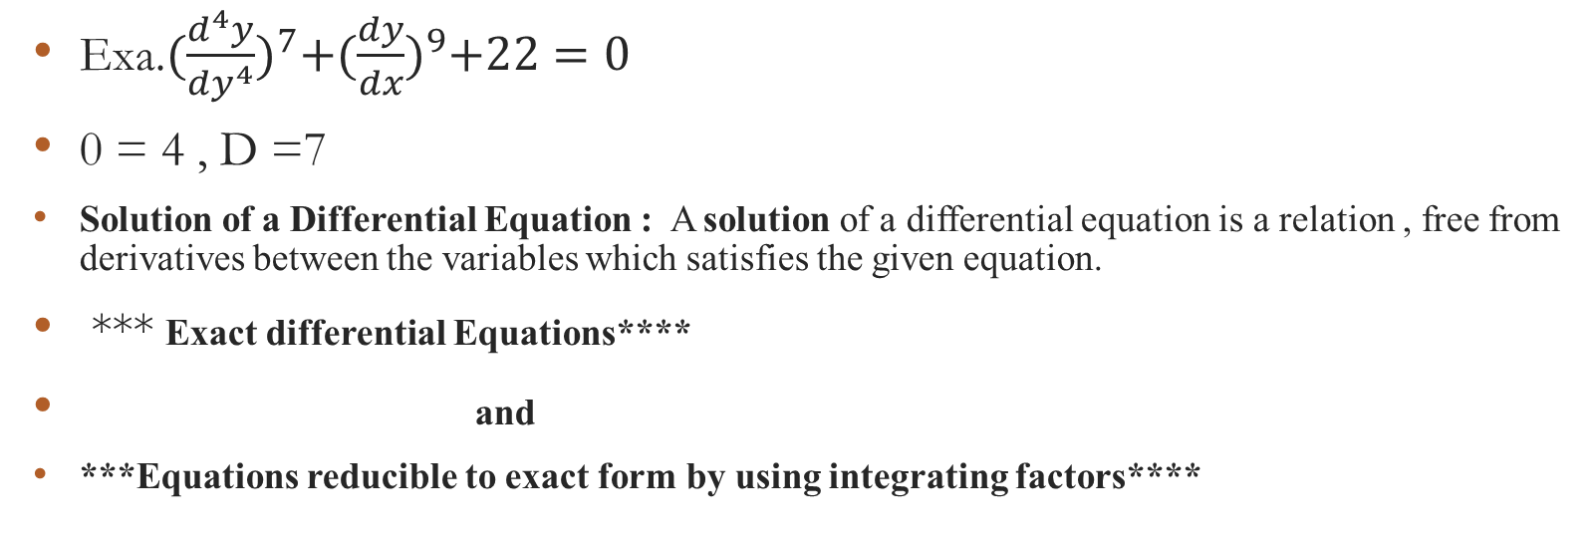

Exa. $2x\frac{d^{4}y}{dy^{4}}+5x^{2}{\left(\frac{dy}{dx}\right)}^{3}−xy=0$ O = 4 , D=1
Exa.${(\frac{d^{4}y}{dy^{4}})}^{7}+{(\frac{dy}{dx})}^{9}+22=0$
0 = 4 , D =7
Solution of a Differential Equation : A solution of a differential equation is a relation , free from derivatives between the variables which satisfies the given equation.
*** Exact differential Equations****
and
***Equations reducible to exact form by using integrating factors****

Slide 10
Exact Differential Equation : Let M(x,y)dx + N(x,y)dy = 0 be a first order and first degree differential equation where M and N are real valued functions for some x, y. Then the equation Mdx + Ndy = 0 is said to be an exact differential equation if ∂M/∂y=∂N/∂x .
Mdx + Ndy = 0………………D.E.
if ∂M/∂y=∂N/∂x
The general solution of exact differential equation is
∫M dx + ∫N dy = c
(keeping y as constant) (terms not containing x)

Slide 11
Exa. Solve 2xy dx + (2 + x²) dy = 0 Solution : Given D.E is 2xy dx + (2 + x²) dy = 0
M = 2xy , N = (2 + x²)
∂M/∂y= 2x , ∂N/∂x = 2x
∂M/∂y=∂N/∂x
Therefore the equation is exact.
The general solution is given by
∫M dx + ∫Ndy = c
(keeping y as constant) (terms not containing x)
∫2xy dx + ∫2dy = c
(keeping y as constant) (terms not containing x)

Slide 12

∫2xy dx + ∫2dy = c (keeping y as constant) (terms not containing x)
2x$\frac{y^{2}}{2}+2y=c$
General solution for given D.E. Is
x$y^{2}+2y=c$
Exa. Solve the equation $\frac{dy}{dx}+\frac{y\cos{x}+\sin{y}+y}{\sin{x+x\cos{y}+x}}=0$
Solution : Step 1: write the equation of the form M(x,y)dx + N(x,y)dy = 0
Cross multiplying, given equation can be written as
(ycosx + siny + y)dx + (sinx + xcosy +x)dy = 0
This is of the form Mdx + Ndy = 0 where M = ycosx + siny + y, N = sinx + xcosy +x

Slide 13
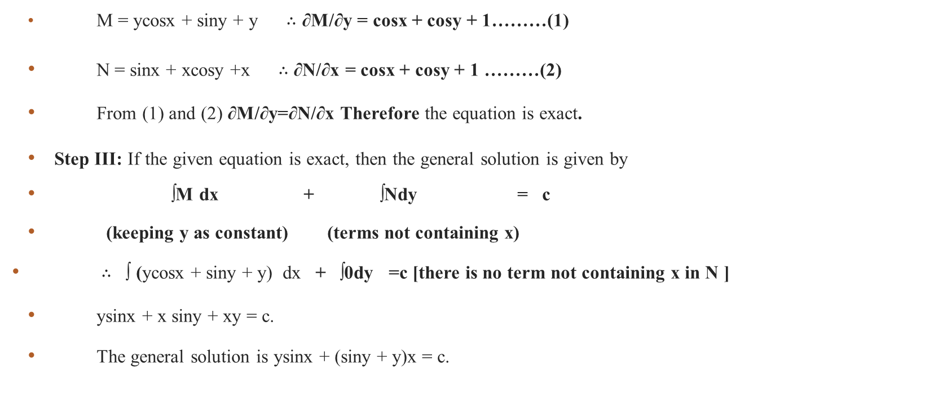
(ycosx + siny + y)dx + (sinx + xcosy +x)dy = 0 Step II : Verify the condition for exactness ∂M/∂y=∂N/∂x
M = ycosx + siny + y $∴$ ∂M/∂y = cosx + cosy + 1………(1)
N = sinx + xcosy +x $∴$ ∂N/∂x = cosx + cosy + 1 ………(2)
From (1) and (2) ∂M/∂y=∂N/∂x Therefore the equation is exact.
Step III: If the given equation is exact, then the general solution is given by
∫M dx + ∫Ndy = c
(keeping y as constant) (terms not containing x)
$∴$ ∫ (ycosx + siny + y) dx + ∫0dy =c [there is no term not containing x in N ]
ysinx + x siny + xy = c.
The general solution is ysinx + (siny + y)x = c.

Slide 14
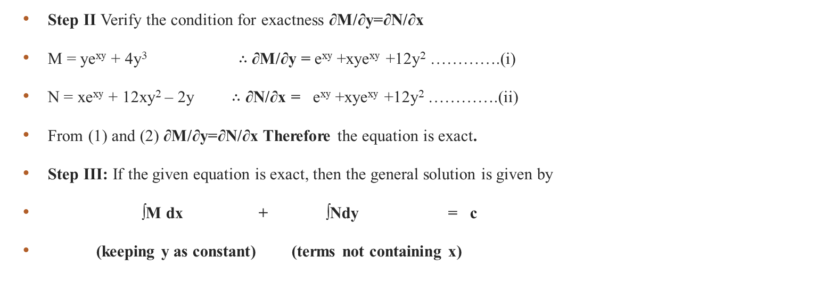
Example 2 : Solve (ye^{xy} + 4y³)dx + (xe^{xy} + 12xy² – 2y)dy = 0, y(0) = 2 Solution: Step I : Given equation is of the form M(x,y)dx + N(x,y)dy = 0 where M = ye^{xy} + 4y³ ; N = xe^{xy} + 12xy² – 2y
Step II Verify the condition for exactness ∂M/∂y=∂N/∂x
M = ye^{xy} + 4y³ $∴$ ∂M/∂y = e^{xy} +xye^{xy} +12y² ………….(i)
N = xe^{xy} + 12xy² – 2y $∴$ ∂N/∂x = e^{xy} +xye^{xy} +12y² ………….(ii)
From (1) and (2) ∂M/∂y=∂N/∂x Therefore the equation is exact.
Step III: If the given equation is exact, then the general solution is given by
∫M dx + ∫Ndy = c
(keeping y as constant) (terms not containing x)

Slide 15


(ye^{xy} + 4y³)dx + (xe^{xy} + 12xy² – 2y)dy = 0……….D.E. $∴$ ∫ (ye^{xy} + 4y³ ) dx + ∫-2ydy = c
$∴$ y[e^{xy}/y] + 4y³x – y² = c.
$∴$ e^{xy} + 4y³x – y² = c ……..(3)
Step IV: Given y(0) = 2 .
Therefore put x = 0 and y = 2 in (3) 1 + 0 – 4 = c. c = -3.
Therefore the general solution is given by e^{xy} + 4y³x – y² = -3.

Slide 16

. Solve [1 + e^{(x/y)]}dx + e^{(x/y)} [1 – x/y]dy = 0 given y(0)=4 [MU 2000] Solution: Step I Given equation is of the form _________________________
where M = [1 + e^{(x/y)]} ; N = e^{(x/y)} [1 – x/y]
Step II: ∂M/∂y = $\frac{−x}{y^{2}}$e^{(x/y)}
∂N/∂x = e^{(x/y)}(-1/y)+ e^{(x/y)} (1/y)[1 – x/y]
=$\frac{−x}{y^{2}}$e^{(x/y)}
∂M/∂y=∂N/∂x Therefore the equation is exact.

Slide 17

General Solution is
∫M dx + ∫Ndy = c
(keeping y as constant) (terms not containing x)
∫[1 + e^{(x/y)]} dx + ∫0 dy = c
X+$\frac{e^{\frac{x}{y}}}{1/y}=c$
$x+y.e^{\frac{x}{y}}=c$

Slide 18
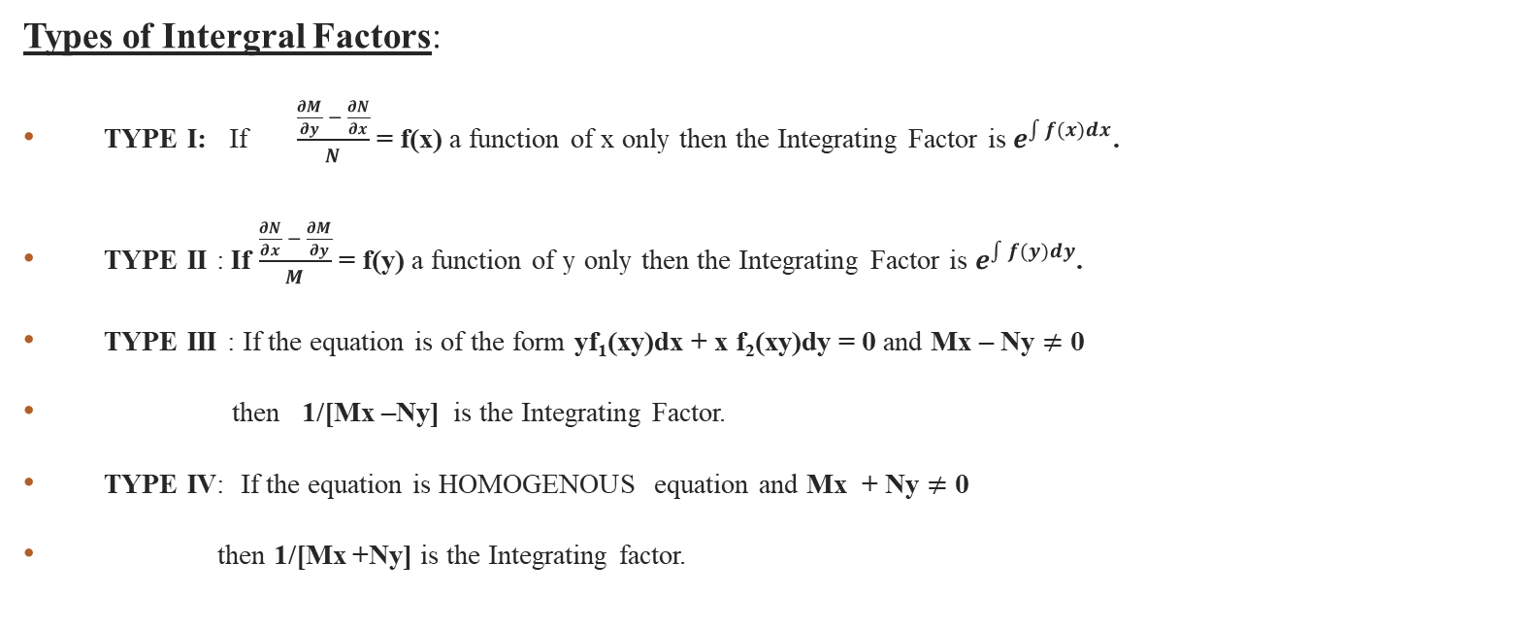
Equations reduced to Exact Differential Equations [By Integral Factors] Sometimes a differential equation is not exact but can be made exact differential equation by multiplying with suitable function. The function is known as Integral Factor [I.F] .After multiplying the given equation by Integral factor, the equations becomes exact and can be solved.
Types of Intergral Factors:
TYPE I: If $\frac{\frac{∂M}{∂y} − \frac{∂N}{∂x}}{N}$ = f(x) a function of x only then the Integrating Factor is $e^{\int{f(x)dx}}$.
TYPE II : If $\frac{\frac{∂N}{∂x} − \frac{∂M}{∂y}}{M}$ = f(y) a function of y only then the Integrating Factor is $e^{\int{f(y)dy}}$.
TYPE III : If the equation is of the form yf₁(xy)dx + x f₂(xy)dy = 0 and Mx – Ny $≠$ 0
then 1/[Mx –Ny] is the Integrating Factor.
TYPE IV: If the equation is HOMOGENOUS equation and Mx + Ny $≠$ 0
then 1/[Mx +Ny] is the Integrating factor.

Slide 19
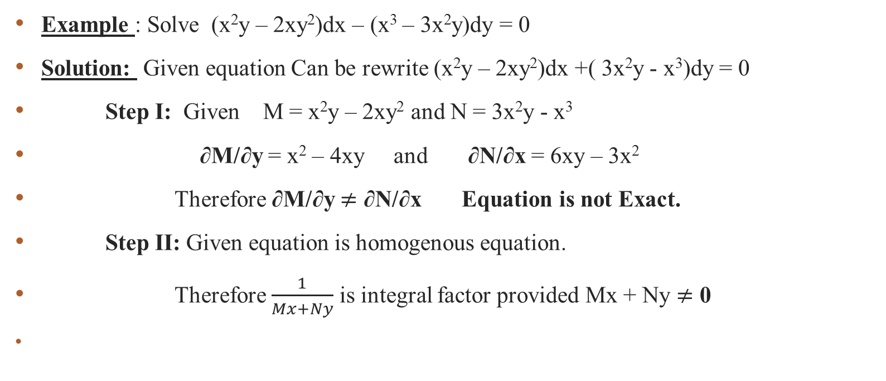

TYPE IV: If the equation is HOMOGENOUS equation and Mx + Ny $≠$ 0 then 1/[Mx +Ny] is the Integrating factor
Example : Solve (x²y – 2xy²)dx – (x³ – 3x²y)dy = 0
Solution: Given equation Can be rewrite (x²y – 2xy²)dx +( 3x²y - x³)dy = 0
Step I: Given M = x²y – 2xy² and N = 3x²y - x³
∂M/∂y = x² – 4xy and ∂N/∂x = 6xy – 3x²
Therefore ∂M/∂y $≠$ ∂N/∂x Equation is not Exact.
Step II: Given equation is homogenous equation.
Therefore $\frac{1}{Mx+Ny}$ is integral factor provided Mx + Ny $≠$ 0

Slide 20
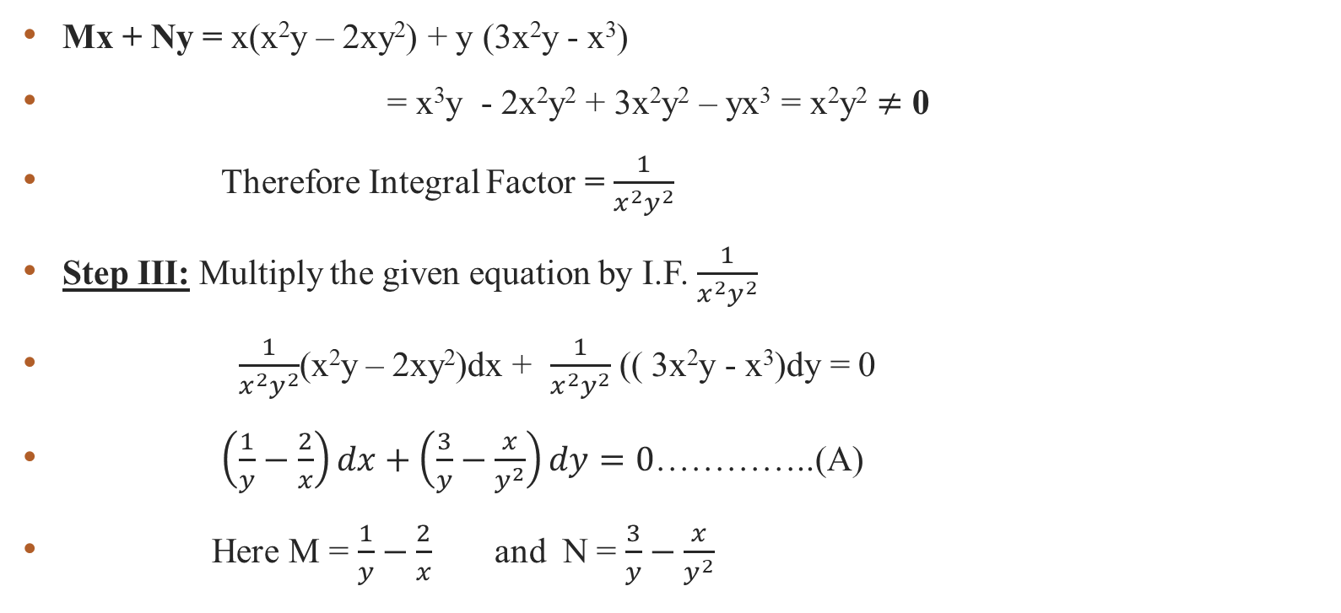
M = x²y – 2xy² and N = 3x²y - x³
Mx + Ny = x(x²y – 2xy²) + y (3x²y - x³)
= x³y - 2x²y² + 3x²y² – yx³ = x²y² $≠$ 0
Therefore Integral Factor = $\frac{1}{x^{2}y^{2}}$
Step III: Multiply the given equation by I.F. $\frac{1}{x^{2}y^{2}}$
$\frac{1}{x^{2}y^{2}}$(x²y – 2xy²)dx + $\frac{1}{x^{2}y^{2}}$ (( 3x²y - x³)dy = 0
$\left(\frac{1}{y}−\frac{2}{x}\right)dx+\left(\frac{3}{y}−\frac{x}{y^{2}}\right)dy=0$…………..(A)
Here M = $\frac{1}{y}−\frac{2}{x}$ and N = $\frac{3}{y}−\frac{x}{y^{2}}$

Slide 21


$∴$ ∂M/∂y = $\frac{−1}{y^{2}}$ and ∂N/∂x = $\frac{−1}{y^{2}}$ $∴$ ∂M/∂y = ∂N/∂x Equation (A) is exact.
Step IV: Since the given equation is exact, then the general solution
is given by ∫M dx + ∫Ndy = c
(keeping y as constant) (terms not containing x)
∫$\left(\frac{1}{y}−\frac{2}{x}\right)$ dx + ∫ $\frac{3}{y}$dy = c.
$\frac{x}{y}−2\log{x+3\log{y=c⇒\frac{x}{y}+\log{\frac{y^{3}}{x^{2}}}}}=c$ which is general solution.

Slide 22
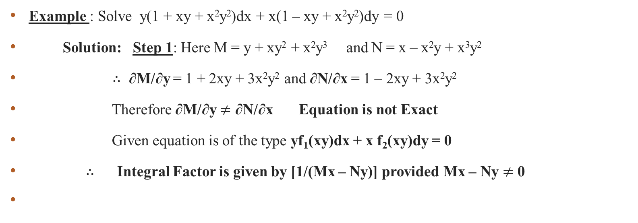

TYPE III : If the equation is of the form yf₁(xy)dx + x f₂(xy)dy = 0 and Mx – Ny $≠$ 0 then 1/[Mx –Ny] is the Integrating Factor
Example : Solve y(1 + xy + x²y²)dx + x(1 – xy + x²y²)dy = 0
Solution: Step 1: Here M = y + xy² + x²y³ and N = x – x²y + x³y²
$∴$ ∂M/∂y = 1 + 2xy + 3x²y² and ∂N/∂x = 1 – 2xy + 3x²y²
Therefore ∂M/∂y $≠$ ∂N/∂x Equation is not Exact
Given equation is of the type yf₁(xy)dx + x f₂(xy)dy = 0
$∴$ Integral Factor is given by [1/(Mx – Ny)] provided Mx – Ny $≠$ 0

Slide 23

Here M = y + xy² + x²y³ and N = x – x²y + x³y² Therefore Mx – Ny = x(y + xy² + x²y³ ) – y( x – x²y + x³y²)
= xy + x²y² + x³y³ – xy + x²y² – x³y³
= 2x²y²$≠$ 0
Therefore I. F. = $\frac{1}{Mx−Ny}=\frac{1}{2x^{2}y^{2}}$.
Step II: Multiply given equation by Integral Factor ,
$\frac{1}{2x^{2}y^{2}}$(y + xy² + x²y³) + $\frac{1}{2x^{2}y^{2}}$ (x – x²y + x³y²) = 0 ………(A)
Here M = $\left(\frac{1}{2x^{2}y}+\frac{1}{2x}+\frac{y}{2}\right)$ and N = $\left(\frac{1}{2xy^{2}}−\frac{1}{2y}+\frac{x}{2}\right)$
$∴$ ∂M/∂y = $\frac{−1}{2x^{2}y^{2}}+\frac{1}{2}$ and ∂N/∂x = $\frac{−1}{2x^{2}y^{2}}+\frac{1}{2}$ $∴$ ∂M/∂y = ∂N/∂x
Equation (A) is exact.

Slide 24

Step III: : Since the given equation is exact, then the general solution is given by ∫M dx + ∫Ndy = c (keeping y as constant) (terms not containing x)
Here M = $\left(\frac{1}{2x^{2}y}+\frac{1}{2x}+\frac{y}{2}\right)$ and N = $\left(\frac{1}{2xy^{2}}−\frac{1}{2y}+\frac{x}{2}\right)$
∫$\left(\frac{1}{2x^{2}y}+\frac{1}{2x}+\frac{y}{2}\right)$ dx + ∫$−\frac{1}{2y}$dy = c $∴$ $−\frac{1}{2xy}+\frac{1}{2}\log{x}+\frac{xy}{2}$ $−\frac{1}{2}\log{y=c}$
$∴$ general solution is $−\frac{1}{2xy}+\frac{1}{2}\log{\frac{x}{y}}+\frac{xy}{2}=c$

Slide 25
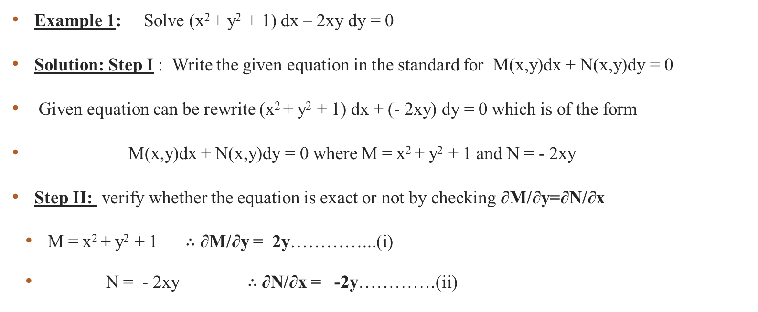
Type I: If $\frac{\frac{∂M}{∂y}−\frac{∂N}{∂x}}{N}$ = f(x) a function of x only then the Integrating Factor is $e^{\int{f(x)dx}}$.
Example 1: Solve (x² + y² + 1) dx – 2xy dy = 0
Solution: Step I : Write the given equation in the standard for M(x,y)dx + N(x,y)dy = 0
Given equation can be rewrite (x² + y² + 1) dx + (- 2xy) dy = 0 which is of the form
M(x,y)dx + N(x,y)dy = 0 where M = x² + y² + 1 and N = - 2xy
Step II: verify whether the equation is exact or not by checking ∂M/∂y=∂N/∂x
M = x² + y² + 1 $∴$ ∂M/∂y = 2y…………...(i)
N = - 2xy $∴$ ∂N/∂x = -2y………….(ii)

Slide 26

Therefore ∂M/∂y $≠$ ∂N/∂x Equation is not Exact.
Step III To find the integral factor; find the value of $\frac{\frac{∂M}{∂y}−\frac{∂N}{∂x}}{N}$ .
$\frac{\frac{∂M}{∂y}−\frac{∂N}{∂x}}{N}$ = $\frac{2y−\left(−2y\right)}{−2xy}=\frac{4y}{−2xy}=−\frac{2}{x}$ =f(x) [function of x only]
Therefore the Integral Factor [I.F] = $e^{\int{f(x)dx}}$ =
= $e^{\int{−\frac{2}{x}dx}}$ = $e^{−2\log{x}}=e^{\log\left(\frac{1}{x^{2}}\right)}$ = $\frac{1}{x^{2}}$ which is the integral factor.

Slide 27
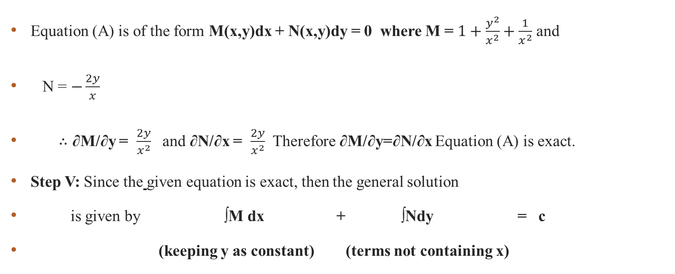

Step IV: Multiply the given equation by IF $\frac{1}{x^{2}}$ $\frac{1}{x^{2}}$ (x² + y² + 1) dx + (-2xy)$\frac{1}{x^{2}}$ dy = 0 $⇒$ $\left(1+\frac{y^{2}}{x^{2}}+\frac{1}{x^{2}}\right)dx+\left(−\frac{2y}{x}\right)dy=0$ …(A)
Equation (A) is of the form M(x,y)dx + N(x,y)dy = 0 where M = $1+\frac{y^{2}}{x^{2}}+\frac{1}{x^{2}}$ and
N = $−\frac{2y}{x}$
$∴$ ∂M/∂y = $\frac{2y}{x^{2}}$ and ∂N/∂x = $\frac{2y}{x^{2}}$ Therefore ∂M/∂y=∂N/∂x Equation (A) is exact.
Step V: Since the given equation is exact, then the general solution
is given by ∫M dx + ∫Ndy = c
(keeping y as constant) (terms not containing x)

Slide 28
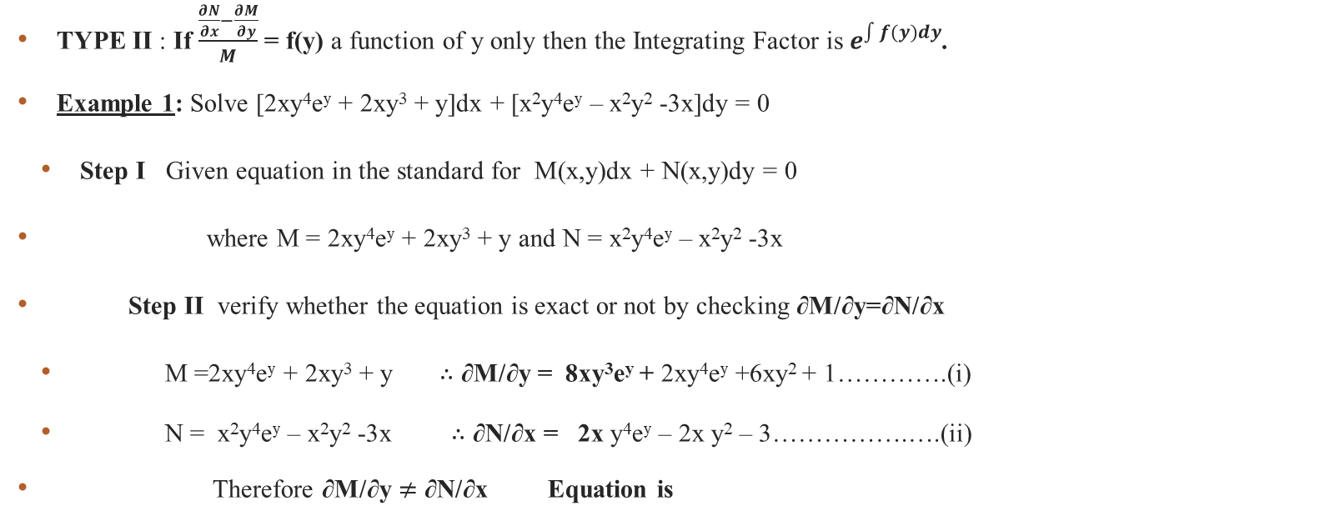

$∴$ ∫ ($1+\frac{y^{2}}{x^{2}}+\frac{1}{x^{2}}$) dx + ∫0dy = c $∴$ [x - $\frac{y^{2}}{x}$ -$\frac{1}{x}$ ]+ 0 = C. General solution is x - $\frac{y^{2}}{x}$ -$\frac{1}{x}$ =C.
TYPE II : If $\frac{\frac{∂N}{∂x}−\frac{∂M}{∂y}}{M}$ = f(y) a function of y only then the Integrating Factor is $e^{\int{f(y)dy}}$.
Example 1: Solve [2xy⁴e^{y} + 2xy³ + y]dx + [x²y⁴e^{y} – x²y² -3x]dy = 0
Step I Given equation in the standard for M(x,y)dx + N(x,y)dy = 0
where M = 2xy⁴e^{y} + 2xy³ + y and N = x²y⁴e^{y} – x²y² -3x
Step II verify whether the equation is exact or not by checking ∂M/∂y=∂N/∂x
M =2xy⁴e^{y} + 2xy³ + y $∴$ ∂M/∂y = 8xy³e^{y} + 2xy⁴e^{y} +6xy² + 1………….(i)
N = x²y⁴e^{y} – x²y² -3x $∴$ ∂N/∂x = 2x y⁴e^{y} – 2x y² – 3…………….….(ii)
Therefore ∂M/∂y $≠$ ∂N/∂x Equation is

Slide 29
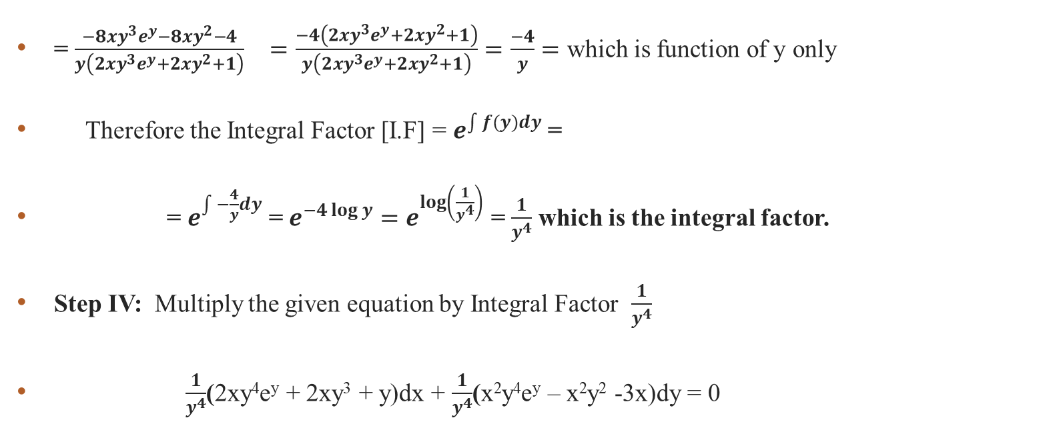

Step III To find the integral factor; find the value of $\frac{\frac{∂N}{∂x}−\frac{∂M}{∂y}}{M}$ . $\frac{\frac{∂N}{∂x}−\frac{∂M}{∂y}}{M}$ = $\frac{\left(2xy^{4}e^{y}−2xy^{2}−3\right)−\left(8xy^{3}e^{y}+2xy^{4}e^{y}+6xy^{2}+1\right)}{2xy^{4}e^{y}+2xy^{3}+y}$
= $\frac{−8xy^{3}e^{y}−8xy^{2}−4}{y\left(2xy^{3}e^{y}+2xy^{2}+1\right)}$ $=\frac{−4\left(2xy^{3}e^{y}+2xy^{2}+1\right)}{y\left(2xy^{3}e^{y}+2xy^{2}+1\right)}=\frac{−4}{y}=$ which is function of y only
Therefore the Integral Factor [I.F] = $e^{\int{f(y)dy}}$ =
= $e^{\int{−\frac{4}{y}dy}}$ = $e^{−4\log{y}}=e^{\log\left(\frac{1}{y^{4}}\right)}$ = $\frac{1}{y^{4}}$ which is the integral factor.
Step IV: Multiply the given equation by Integral Factor $\frac{1}{y^{4}}$
$\frac{1}{y^{4}}$(2xy⁴e^{y} + 2xy³ + y)dx + $\frac{1}{y^{4}}$(x²y⁴e^{y} – x²y² -3x)dy = 0

Slide 30


$\left(2xe^{y}+\frac{2x}{y}+\frac{1}{y^{3}}\right)dx+\left(x^{2}e^{y}−\frac{x^{2}}{y^{2}}−\frac{3x}{y^{4}}\right)dy=0$ ……….(A)
Equation (A) is of the form M(x,y)dx + N(x,y)dy = 0
Where M = $2xe^{y}+\frac{2x}{y}+\frac{1}{y^{3}}$ and N = $x^{2}e^{y}−\frac{x^{2}}{y^{2}}−\frac{3x}{y^{4}}$
$∴$ ∂M/∂y = $2xe^{y}−\frac{2x}{y^{2}}−\frac{3}{y^{4}}$ and ∂N/∂x = 2x$e^{y}−\frac{2x}{y^{2}}−\frac{3}{y^{4}}$
Therefore ∂M/∂y = ∂N/∂x Equation (A) is exact.

Slide 31
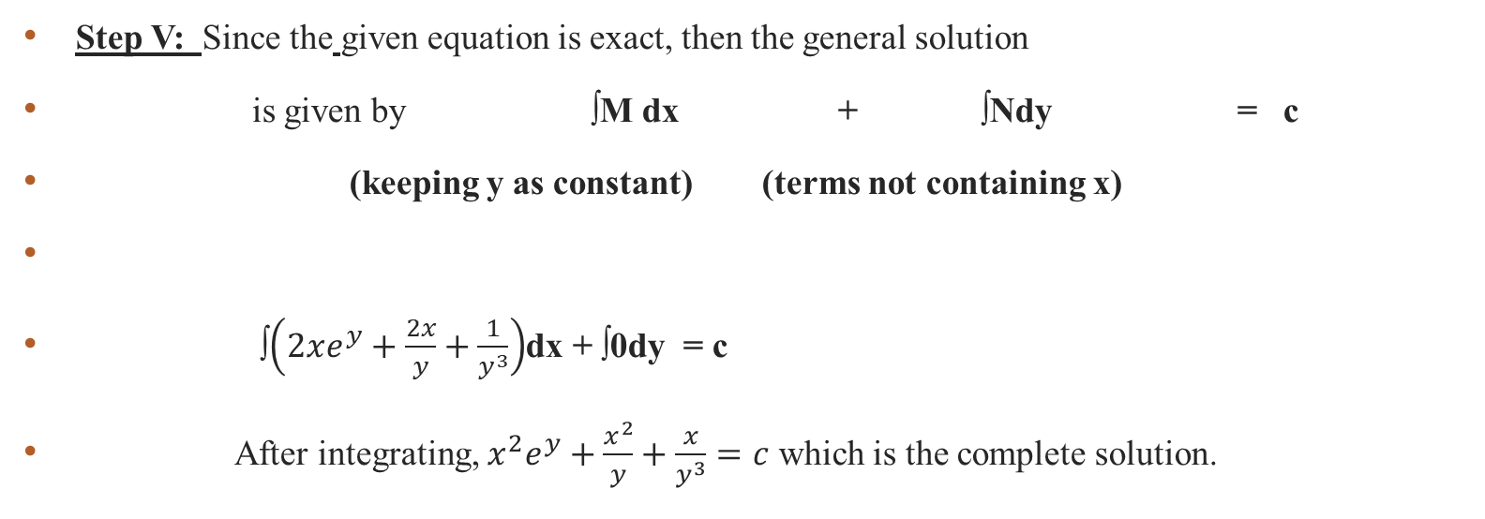

$\left(2xe^{y}+\frac{2x}{y}+\frac{1}{y^{3}}\right)dx+\left(x^{2}e^{y}−\frac{x^{2}}{y^{2}}−\frac{3x}{y^{4}}\right)dy=0$ ……….(A)
Step V: Since the given equation is exact, then the general solution
is given by ∫M dx + ∫Ndy = c
(keeping y as constant) (terms not containing x)
∫$\left(2xe^{y}+\frac{2x}{y}+\frac{1}{y^{3}}\right)$dx + ∫0dy = c
After integrating, $x^{2}e^{y}+\frac{x^{2}}{y}+\frac{x}{y^{3}}=c$ which is the complete solution.

Slide 32
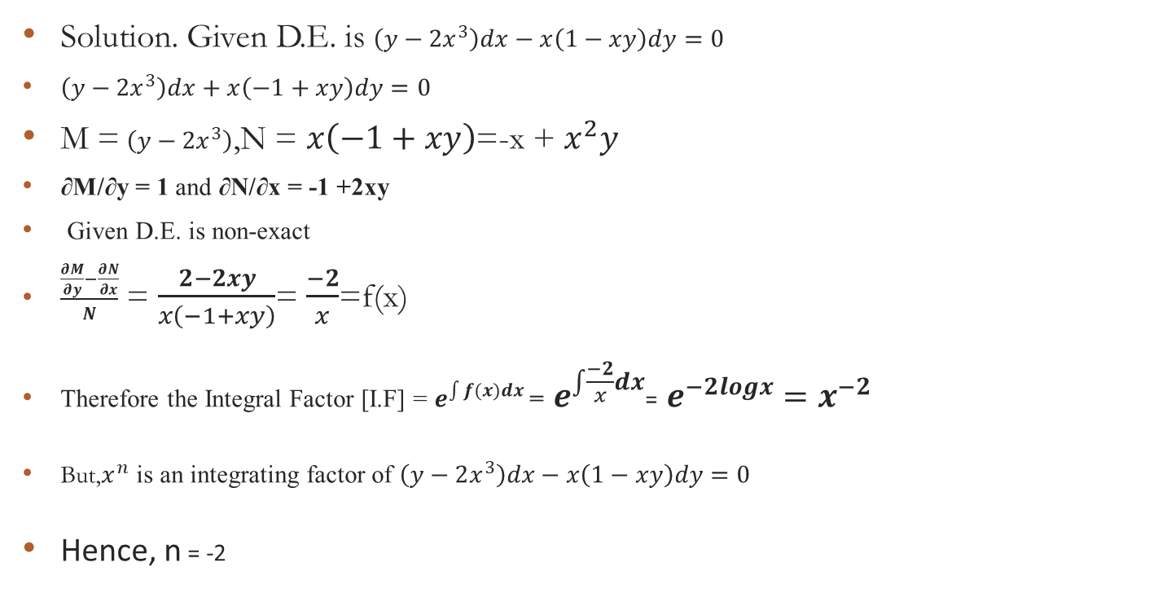
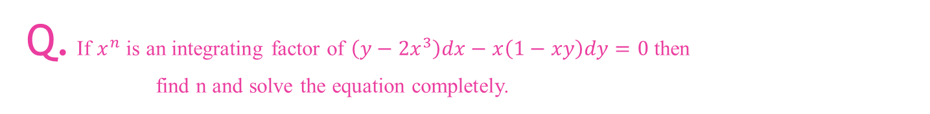
Q. If $x^{n}$ is an integrating factor of $\left(y−2x^{3}\right)dx−x\left(1−xy\right)dy=0$ then find n and solve the equation completely.
Solution. Given D.E. is $\left(y−2x^{3}\right)dx−x\left(1−xy\right)dy=0$
$\left(y−2x^{3}\right)dx+x\left(−1+xy\right)dy=0$
M = $\left(y−2x^{3}\right)$,N = $x\left(−1+xy\right)$=-x + $x^{2}y$
∂M/∂y = 1 and ∂N/∂x = -1 +2xy
Given D.E. is non-exact
$\frac{\frac{∂M}{∂y}−\frac{∂N}{∂x}}{N}$ = $\frac{2−2xy}{x\left(−1+xy\right)}$= $\frac{−2}{x}$=f(x)
Therefore the Integral Factor [I.F] = $e^{\int{f(x)dx}}$ = $e^{\int{\frac{−2}{x}dx}}$= $e^{−2logx}=x^{−2}$
But,$x^{n}$ is an integrating factor of $\left(y−2x^{3}\right)dx−x\left(1−xy\right)dy=0$
Hence, n = -2

Slide 33
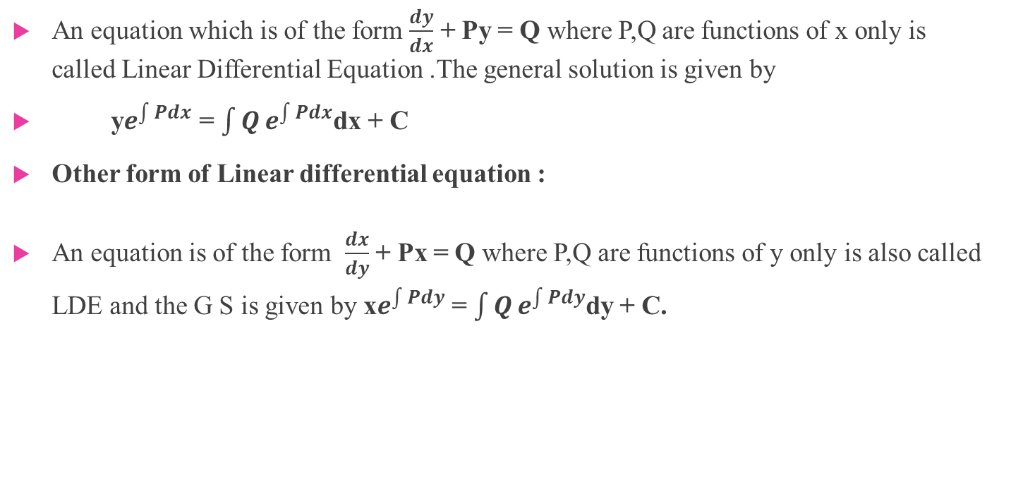
Linear differential equations (Review), equation reducible to linear form, Bernoulli’s equation : LINEAR DIFFERENTIAL EQUATIONS : A differential equation is said to be linear if the dependent variable and its derivatives appear only in the first degree.
An equation which is of the form $\frac{dy}{dx}$ + Py = Q where P,Q are functions of x only is called Linear Differential Equation .The general solution is given by
y$e^{\int{Pdx}}$ = $\int{Q}e^{\int{Pdx}}$dx + C
Other form of Linear differential equation :
An equation is of the form $\frac{dx}{dy}$ + Px = Q where P,Q are functions of y only is also called LDE and the G S is given by x$e^{\int{Pdy}}$ = $\int{Q}e^{\int{Pdy}}$dy + C.

Slide 34
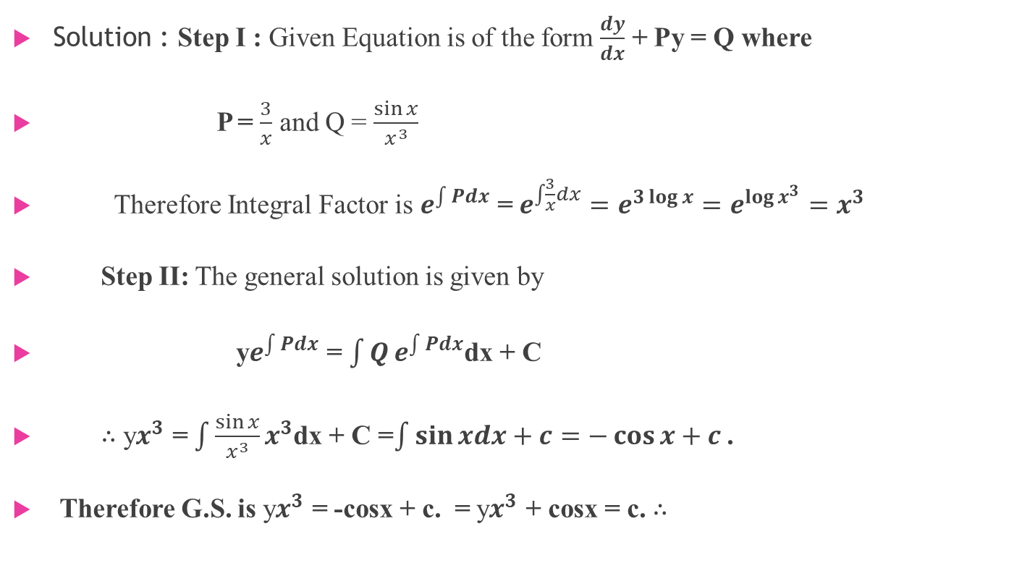
Example : Solve $\frac{dy}{dx}+\frac{3y}{x}=\frac{\sin{x}}{x^{3}}$
Solution : Step I : Given Equation is of the form $\frac{dy}{dx}$ + Py = Q where
P = $\frac{3}{x}$ and Q = $\frac{\sin{x}}{x^{3}}$
Therefore Integral Factor is $e^{\int{Pdx}}$ = $e^{\int{\frac{3}{x}dx}}=e^{3\log{x}}=e^{\log{x^{3}}}=x^{3}$
Step II: The general solution is given by
y$e^{\int{Pdx}}$ = $\int{Q}e^{\int{Pdx}}$dx + C
∴ y$x^{3}$ = $\int{\frac{\sin{x}}{x^{3}}}x^{3}$dx + C =$\int{\sin{xdx+c=−\cos{x+c}}}$ .
Therefore G.S. is y$x^{3}$ = -cosx + c. = y$x^{3}$ + cosx = c. ∴

Slide 35
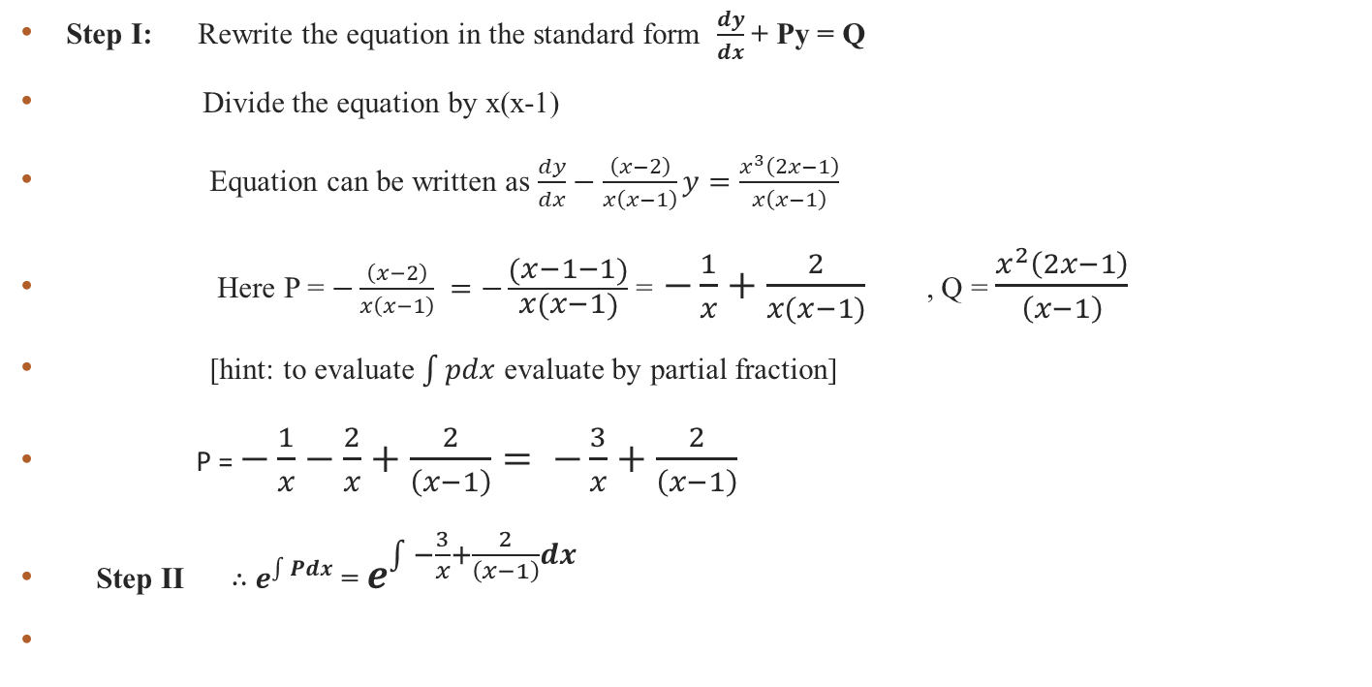

Q.Solve x(x-1)$\frac{dy}{dx}$ – (x-2)y = x³(2x-1)
Step I: Rewrite the equation in the standard form $\frac{dy}{dx}$ + Py = Q
Divide the equation by x(x-1)
Equation can be written as $\frac{dy}{dx}−\frac{\left(x−2\right)}{x\left(x−1\right)}y=\frac{x^{3}\left(2x−1\right)}{x\left(x−1\right)}$
Here P = $−\frac{\left(x−2\right)}{x\left(x−1\right)} =−\frac{\left(x−1−1\right)}{x\left(x−1\right)}$ = $−\frac{1}{x}+\frac{2}{x(x−1)}$ , Q = $\frac{x^{2}\left(2x−1\right)}{\left(x−1\right)}$
[hint: to evaluate $\int{pdx}$ evaluate by partial fraction]
P = $−\frac{1}{x}−\frac{2}{x}+\frac{2}{\left(x−1\right)}= −\frac{3}{x}+\frac{2}{\left(x−1\right)}$
Step II ∴ $e^{\int{Pdx}}$ = $e^{\int{−\frac{3}{x}+\frac{2}{\left(x−1\right)}dx}}$

Slide 36
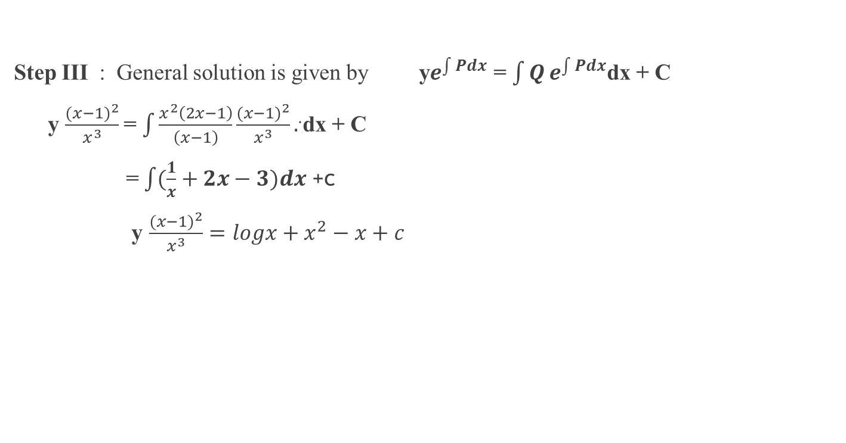

$\int{[−\frac{3}{x}+\frac{2}{\left(x−1\right)}]dx}$ = -3logx +2 log(x-1) = log[$\frac{{(x−1)}^{2}}{x^{3}}]$ $e^{\int{−\frac{3}{x}+\frac{2}{\left(x−1\right)}dx}}$ = $e^{\text{log}\text{[}\frac{{(x−1)}^{2}}{x^{3}}] }=$ $\frac{{(x−1)}^{2}}{x^{3}}$
Step III : General solution is given by y$e^{\int{Pdx}}$ = $\int{Q}e^{\int{Pdx}}$dx + C
y $\frac{{(x−1)}^{2}}{x^{3}}$= $\int{\frac{x^{2}\left(2x−1\right)}{\left(x−1\right)}}{\frac{{(x−1)}^{2}}{x^{3}}.}^{.}$dx + C
= $\int{(\frac{1}{x}+2x−3)dx}$ +c
y $\frac{{(x−1)}^{2}}{x^{3}}=logx+x^{2}−x+c$

Slide 37
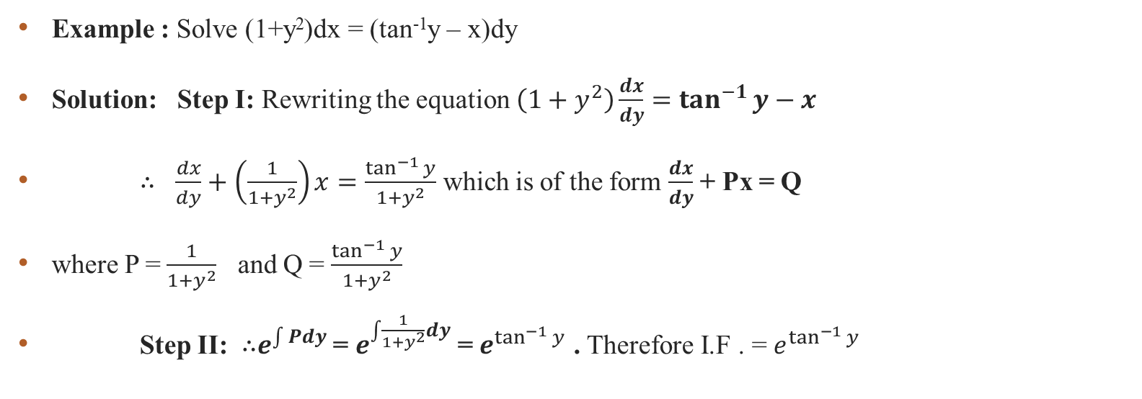
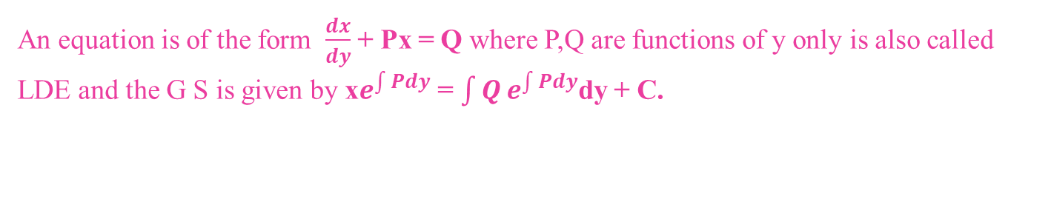
An equation is of the form $\frac{dx}{dy}$ + Px = Q where P,Q are functions of y only is also called LDE and the G S is given by x$e^{\int{Pdy}}$ = $\int{Q}e^{\int{Pdy}}$dy + C.
Example : Solve (1+y²)dx = (tan⁻¹y – x)dy
Solution: Step I: Rewriting the equation $\left(1+y^{2}\right)\frac{dx}{dy}=\tan^{−1}{y−x}$
∴ $\frac{dx}{dy}+\left(\frac{1}{1+y^{2}}\right)x=\frac{\tan^{−1}{y}}{1+y^{2}}$ which is of the form $\frac{dx}{dy}$ + Px = Q
where P = $\frac{1}{1+y^{2}}$ and Q = $\frac{\tan^{−1}{y}}{1+y^{2}}$
Step II: ∴$e^{\int{Pdy}}$ = $e^{\int{\frac{1}{1+y^{2}}dy}}$ = $e^{\tan^{−1}{y}}$ . Therefore I.F . = $e^{\tan^{−1}{y}}$

Slide 38

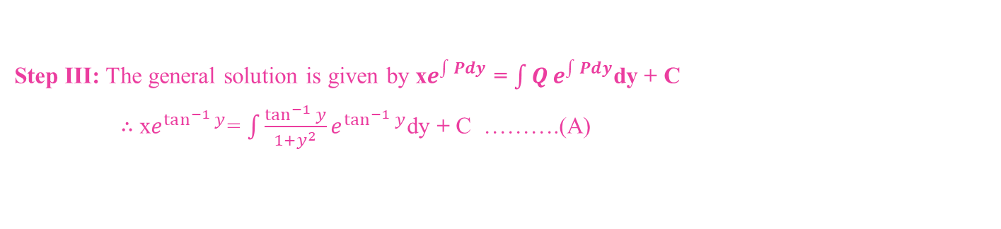
Step III: The general solution is given by x$e^{\int{Pdy}}$ = $\int{Q}e^{\int{Pdy}}$dy + C ∴ x$e^{\tan^{−1}{y}}$= $\int{\frac{\tan^{−1}{y}}{1+y^{2}}}e^{\tan^{−1}{y}}$dy + C ……….(A)
Consider $\int{\frac{\tan^{−1}{y}}{1+y^{2}}}e^{\tan^{−1}{y}}$dy put tan⁻¹y = t. ∴ dt = $\frac{1}{1+y^{2}}dy$
∴ $\int{\frac{\tan^{−1}{y}}{1+y^{2}}}e^{\tan^{−1}{y}}$dy = $\int{e^{t}t}$dy = te^{t} – e^{t} [by integration by parts]
From Equation (A) x$e^{\tan^{−1}{y}}$=e^{t}(t- 1) + c
=$e^{\tan^{−1}{y}}$( tan⁻¹y - 1) + C [put the value of t = tan⁻¹y)
∴ General Solution is x = tan⁻¹y – 1 + $\frac{c}{e^{\tan^{−1}{y}}}$
= tan⁻¹y – 1 + c $e^{{−tan}^{−1}{y}}$

Slide 39
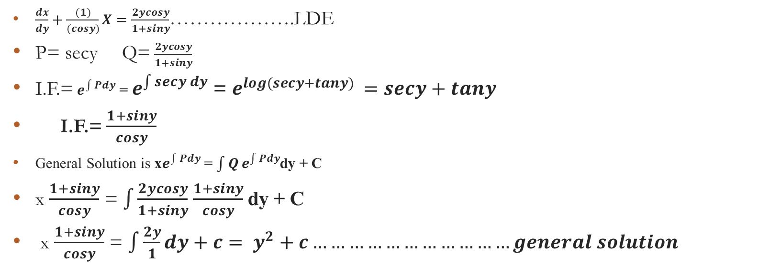
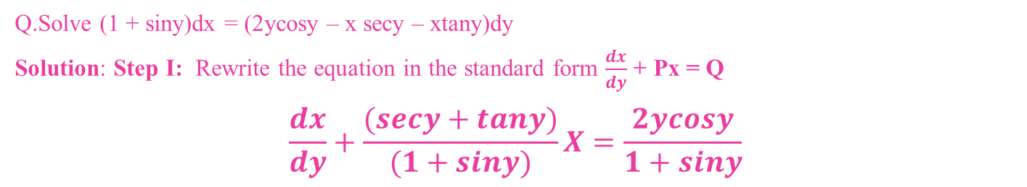
Q.Solve (1 + siny)dx = (2ycosy – x secy – xtany)dy Solution: Step I: Rewrite the equation in the standard form $\frac{dx}{dy}$ + Px = Q $$\frac{dx}{dy}+\frac{(secy+tany)}{(1+siny)}X=\frac{2ycosy}{1+siny}$$
$\frac{dx}{dy}+\frac{(1)}{(cosy)}X=\frac{2ycosy}{1+siny}$……………….LDE
P= secy Q= $\frac{2ycosy}{1+siny}$
I.F.= $e^{\int{Pdy}}$ = $e^{\int{secy dy}}$ = $e^{log(secy+tany) }=secy+tany$
I.F.= $\frac{1+siny}{cosy}$
General Solution is x$e^{\int{Pdy}}$ = $\int{Q}e^{\int{Pdy}}$dy + C
x $\frac{1+siny}{cosy}$ = $\int{\frac{2ycosy}{1+siny}}$ $\frac{1+siny}{cosy}$dy + C
x $\frac{1+siny}{cosy}$ = $\int{\frac{2y}{1}dy+c}= y^{2}+c……………………………general solution$

Slide 40
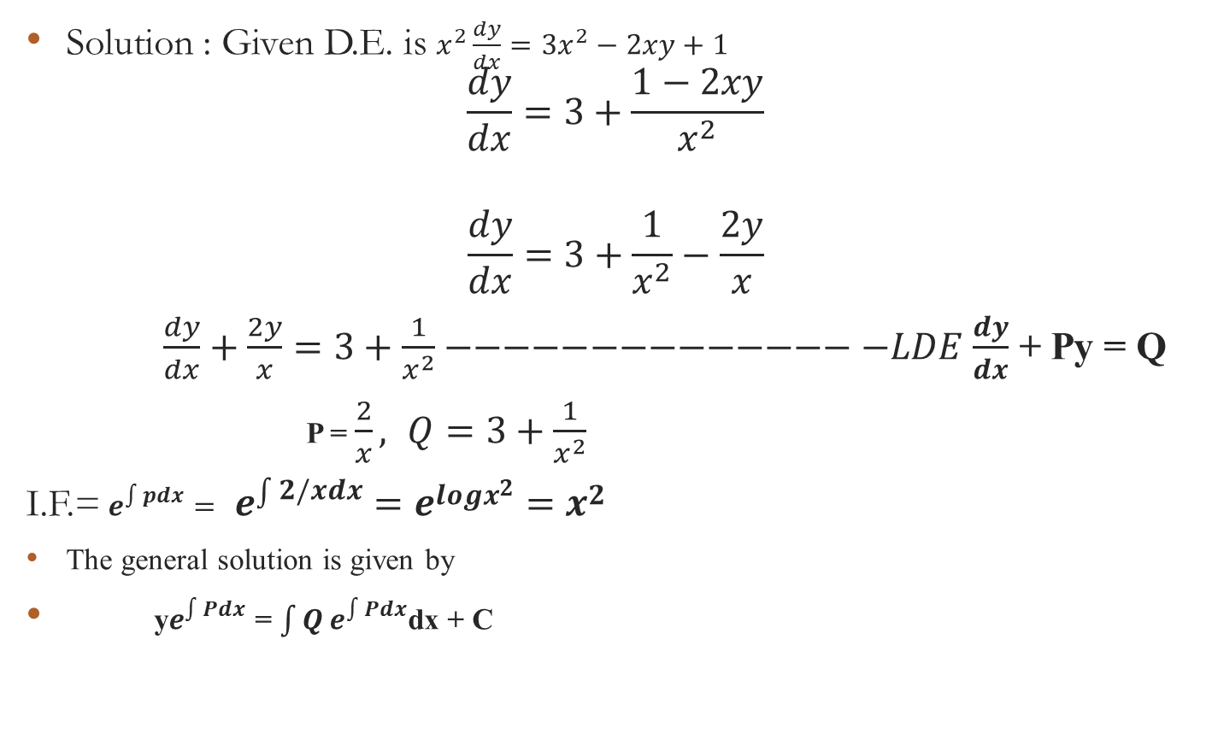
Q. Solve $x^{2}\frac{dy}{dx}=3x^{2}−2xy+1$ Try for LDE
Solution : Given D.E. is $x^{2}\frac{dy}{dx}=3x^{2}−2xy+1$ $\frac{dy}{dx}=3+\frac{1−2xy}{x^{2}}$
$$\frac{dy}{dx}=3+\frac{1}{x^{2}}−\frac{2y}{x}$$
$\frac{dy}{dx}+\frac{2y}{x}=3+\frac{1}{x^{2}}−−−−−−−−−−−−−−−LDE$ $\frac{dy}{dx}$ + Py = Q
P = $\frac{2}{x}, Q=3+\frac{1}{x^{2}}$
I.F.= $e^{\int{pdx}}= e^{\int{2/xdx}}=e^{logx^{2}}=x^{2}$
The general solution is given by
y$e^{\int{Pdx}}$ = $\int{Q}e^{\int{Pdx}}$dx + C

Slide 41
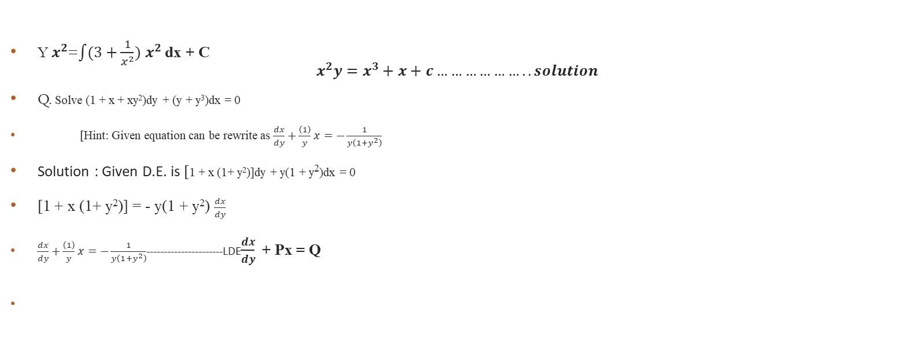
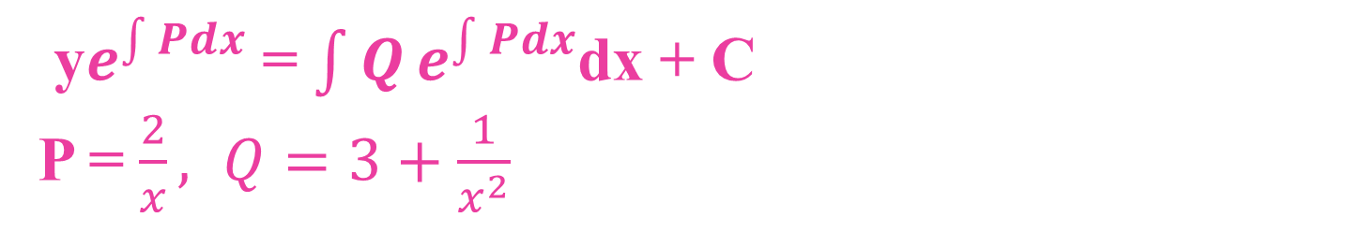
y$e^{\int{Pdx}}$ = $\int{Q}e^{\int{Pdx}}$dx + C P = $\frac{2}{x}, Q=3+\frac{1}{x^{2}}$
Y $x^{2}$=$\int{(3+\frac{1}{x^{2}})}$ $x^{2}$dx + C $x^{2}y=x^{3}+x+c………………..solution$
Q. Solve (1 + x + xy²)dy + (y + y³)dx = 0
[Hint: Given equation can be rewrite as $\frac{dx}{dy}+\frac{\left(1\right)}{y}x=−\frac{1}{y\left(1+y^{2}\right)}$
Solution : Given D.E. is [1 + x (1+ y²)]dy + y(1 + y²)dx = 0
[1 + x (1+ y²)] = - y(1 + y²) $\frac{dx}{dy}$
$\frac{dx}{dy}+\frac{\left(1\right)}{y}x=−\frac{1}{y\left(1+y^{2}\right)}$----------------------LDE$\frac{dx}{dy}$ + Px = Q

Slide 42
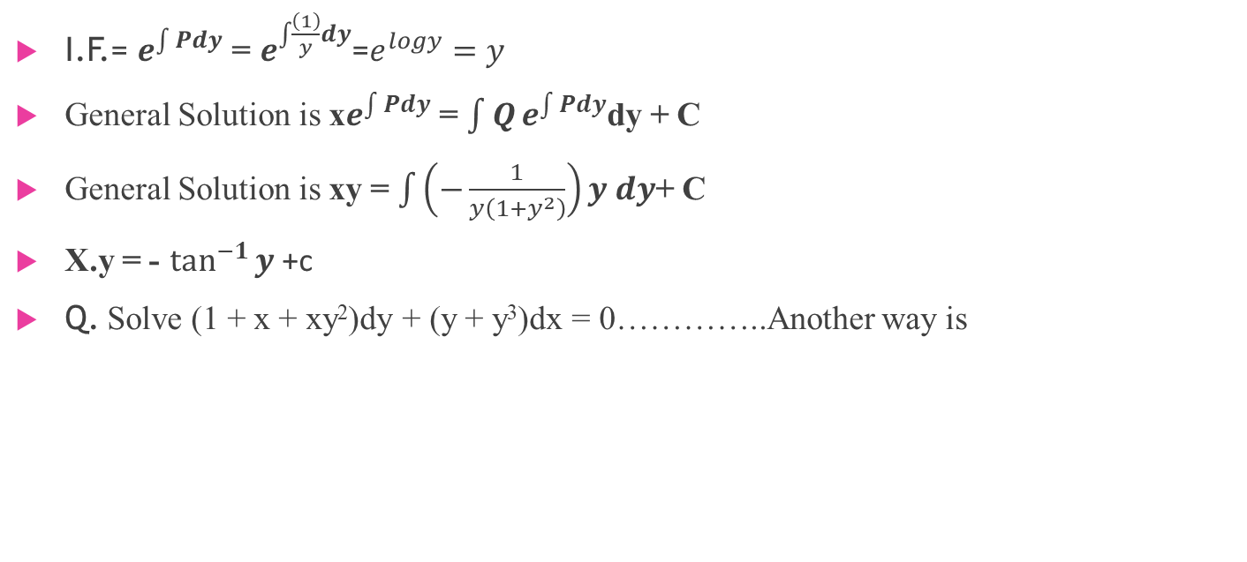
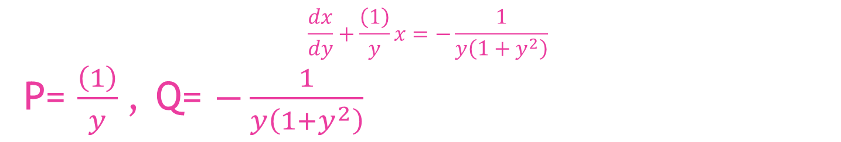
$$\frac{dx}{dy}+\frac{\left(1\right)}{y}x=−\frac{1}{y\left(1+y^{2}\right)}$$ P= $\frac{\left(1\right)}{y}$, Q= $−\frac{1}{y\left(1+y^{2}\right)}$
I.F.= $e^{\int{Pdy}}$ = $e^{\int{\frac{\left(1\right)}{y}dy}}$=$e^{logy}=y$
General Solution is x$e^{\int{Pdy}}$ = $\int{Q}e^{\int{Pdy}}$dy + C
General Solution is xy = $\int{\left(−\frac{1}{y\left(1+y^{2}\right)}\right)y dy}$+ C
X.y = - $\tan^{−1}{y}$ +c
Q. Solve (1 + x + xy²)dy + (y + y³)dx = 0…………..Another way is

Slide 43
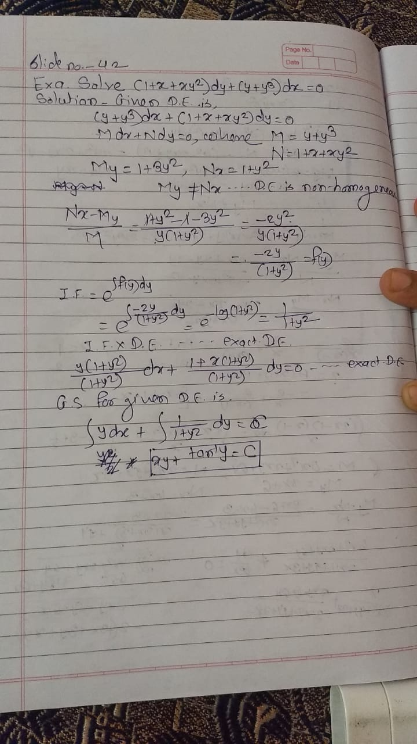

Slide 44
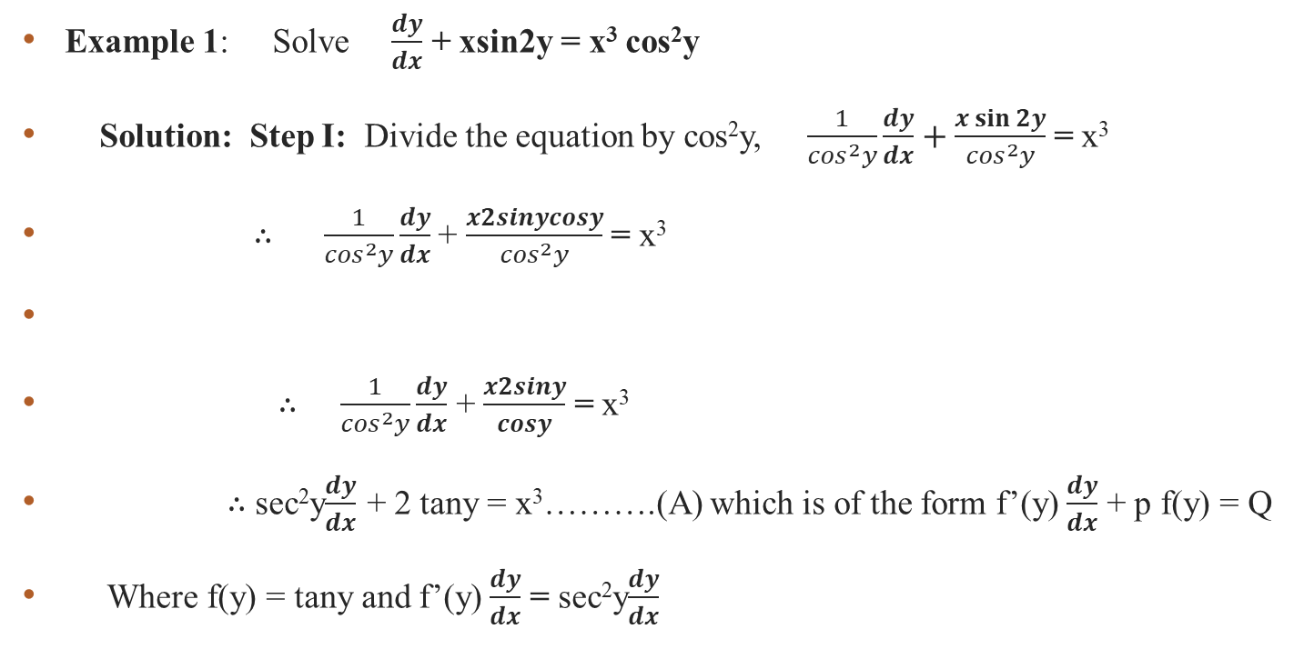
Equations reduced to Linear Differential Equation. If the given equation if not linear differential equations, it can be reduced to linear differential equation and then solved.
Example 1: Solve $\frac{dy}{dx}$ + xsin2y = x³ cos²y
Solution: Step I: Divide the equation by cos²y, $\frac{1}{\cos^{2}y}\frac{dy}{dx}+\frac{x\sin{2y}}{\cos^{2}y}$ = x³
∴ $\frac{1}{\cos^{2}y}\frac{dy}{dx}$ + $\frac{x2sinycosy}{\cos^{2}y}$ = x³
∴ $\frac{1}{\cos^{2}y}\frac{dy}{dx}$ + $\frac{x2siny}{cosy}$ = x³
∴ sec²y$\frac{dy}{dx}$ + 2 tany = x³……….(A) which is of the form f’(y)$\frac{dy}{dx}$ + p f(y) = Q
Where f(y) = tany and f’(y)$\frac{dy}{dx}$ = sec²y$\frac{dy}{dx}$

Slide 45

∴ sec²y$\frac{dy}{dx}$ + 2 tany = x³……….(A)
Step II: Let v = tany ∴ $\frac{dv}{dx}$ = sec²y$\frac{dy}{dx}$
Substituting these values in equation (A)
$\frac{dv}{dx}$ + 2vx = x³ ………(B)which is linear differential equation is of the form
$\frac{dy}{dx}+Py=Q$ where P =2x ,Q = x³
∴ I.F. =$e^{\int{2xdx}}=e^{x^{2}}$
The solution of equation (B) is given by v$e^{x^{2}}$ = $\int{x^{3}e^{x^{2}}}dx+c$
Consider $\int{x^{3}e^{x^{2}}}dx$ Put x² = t . ∴ 2xdx = dt. ∴ xdx = $\frac{dt}{2}$
$\int{x^{3}e^{x^{2}}}dx$ = $\int{e^{t}\frac{t}{2}}dt=\frac{1}{2}\left(te^{t}−e^{t}\right)$ [by integral by parts]

Slide 46
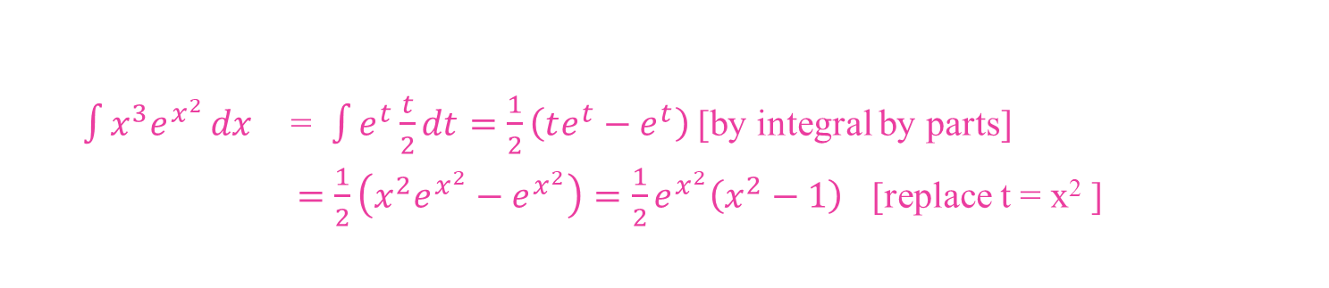

$\int{x^{3}e^{x^{2}}}dx$ = $\int{e^{t}\frac{t}{2}}dt=\frac{1}{2}\left(te^{t}−e^{t}\right)$ [by integral by parts] $=\frac{1}{2}\left(x^{2}e^{x^{2}}−e^{x^{2}}\right)=\frac{1}{2}e^{x^{2}}\left(x^{2}−1\right)$ [replace t = x² ]
Step III : General solution is v$e^{x^{2}}$ = $\frac{1}{2}e^{x^{2}}\left(x^{2}−1\right)$ + c
Put v = tany, tany $e^{x^{2}}$= $\frac{1}{2}e^{x^{2}}\left(x^{2}−1\right)$ + c
∴ tany = $\frac{1}{2}\left(x^{2}−1\right)$+ c $e^{{−x}^{2}}$

Slide 47
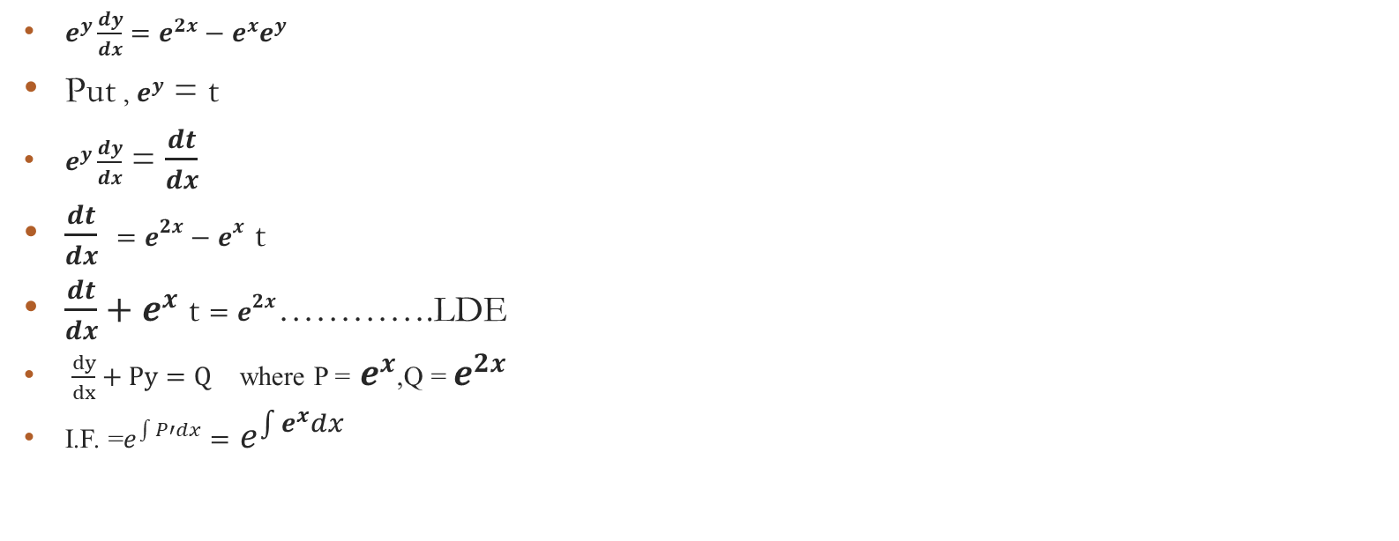
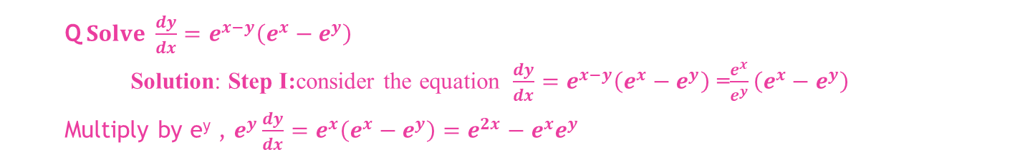
Q$Solve \frac{dy}{dx}=e^{x−y}\left(e^{x}−e^{y}\right)$ Solution: Step I:consider the equation $\frac{dy}{dx}=e^{x−y}\left(e^{x}−e^{y}\right)$ =$\frac{e^{x}}{e^{y}}\left(e^{x}−e^{y}\right)$ Multiply by e^{y} , $e^{y}\frac{dy}{dx}=e^{x}\left(e^{x}−e^{y}\right)=e^{2x}−e^{x}e^{y}$
$e^{y}\frac{dy}{dx}=e^{2x}−e^{x}e^{y}$
Put , $e^{y}$ = t
$e^{y}\frac{dy}{dx}$ = $\frac{dt}{dx}$
$\frac{dt}{dx} =e^{2x}−e^{x}$ t
$\frac{dt}{dx}+e^{x} \text{t}=e^{2x}$………….LDE
$\frac{dy}{dx}+Py=Q$ where P = $e^{x}$,Q = $e^{2x}$
I.F. =$e^{\int{P′dx}}=$ $e^{\int{e^{x}dx}}$

Slide 48
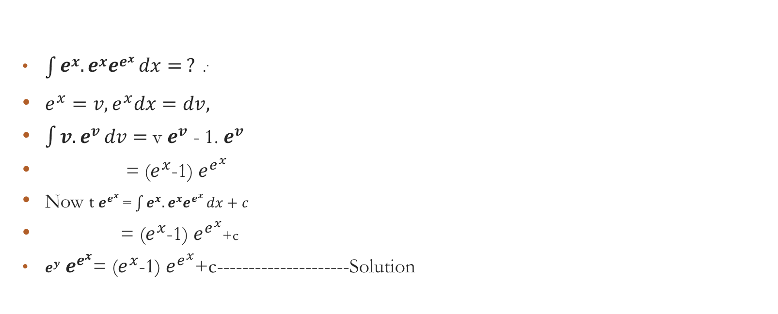
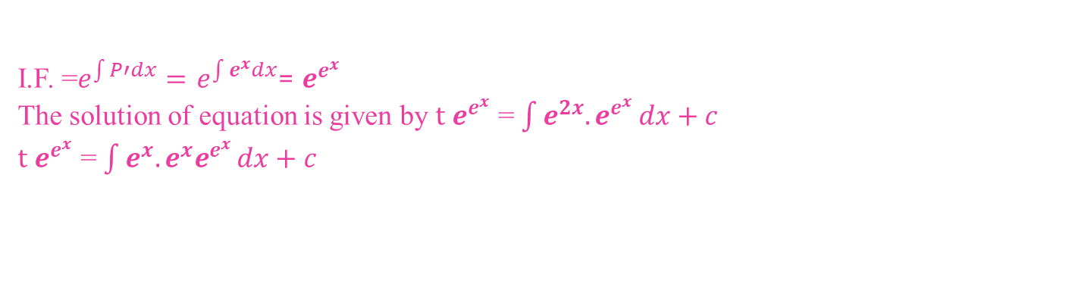
I.F. =$e^{\int{P′dx}}=$ $e^{\int{e^{x}dx}}$= $e^{e^{x}}$ The solution of equation is given by $t$ $e^{e^{x}}$ = $\int{e^{2x}.e^{e^{x}}}dx+c$ $t$ $e^{e^{x}}$ = $\int{e^{x}.e^{x}e^{e^{x}}}dx+c$
${\int{e^{x}.e^{x}e^{e^{x}}}dx= ? .}^{.}$
$e^{x}=v, e^{x}dx=dv,$
$\int{v. e^{v}}dv=$v $e^{v}$ - 1. $e^{v}$
= ($e^{x}$-1) $e^{e^{x}}$
Now $t$ $e^{e^{x}}$ = $\int{e^{x}.e^{x}e^{e^{x}}}dx+c$
= ($e^{x}$-1) $e^{e^{x}}$+c
$e^{y}$ $e^{e^{x}}$= ($e^{x}$-1) $e^{e^{x}}$+c---------------------Solution

Slide 49

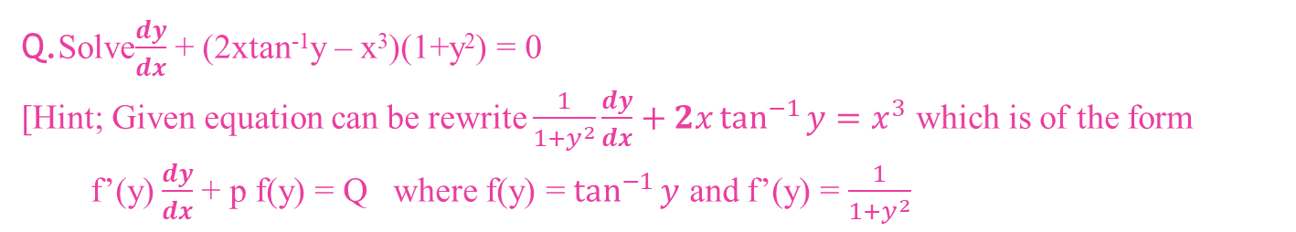
Q.Solve$\frac{dy}{dx}$ + (2xtan⁻¹y – x³)(1+y²) = 0 [Hint; Given equation can be rewrite $\frac{1}{1+y^{2}}\frac{dy}{dx}+2x\tan^{−1}{y=x^{3}}$ which is of the form f’(y)$\frac{dy}{dx}$ + p f(y) = Q where f(y) = $\tan^{−1}{y}$ and f’(y) = $\frac{1}{1+y^{2}}$
Solution. We have D.E. is $\frac{dy}{dx}$ + (2xtan⁻¹y – x³)(1+y²) = 0
$\frac{1}{1+y^{2}}\frac{dy}{dx}$ + (2xtan⁻¹y – x³)= 0
$\frac{1}{1+y^{2}}\frac{dy}{dx}+2x\tan^{−1}{y=x^{3}}$…………………………….x,y
Put, $\tan^{−1}{y=v}$,
$\frac{1}{1+y^{2}}\frac{dy}{dx}$ = $\frac{dv}{dx}$
$\frac{dv}{dx}$+2xv= $x^{3}$………………………………………….x,v…LDE

Slide 50
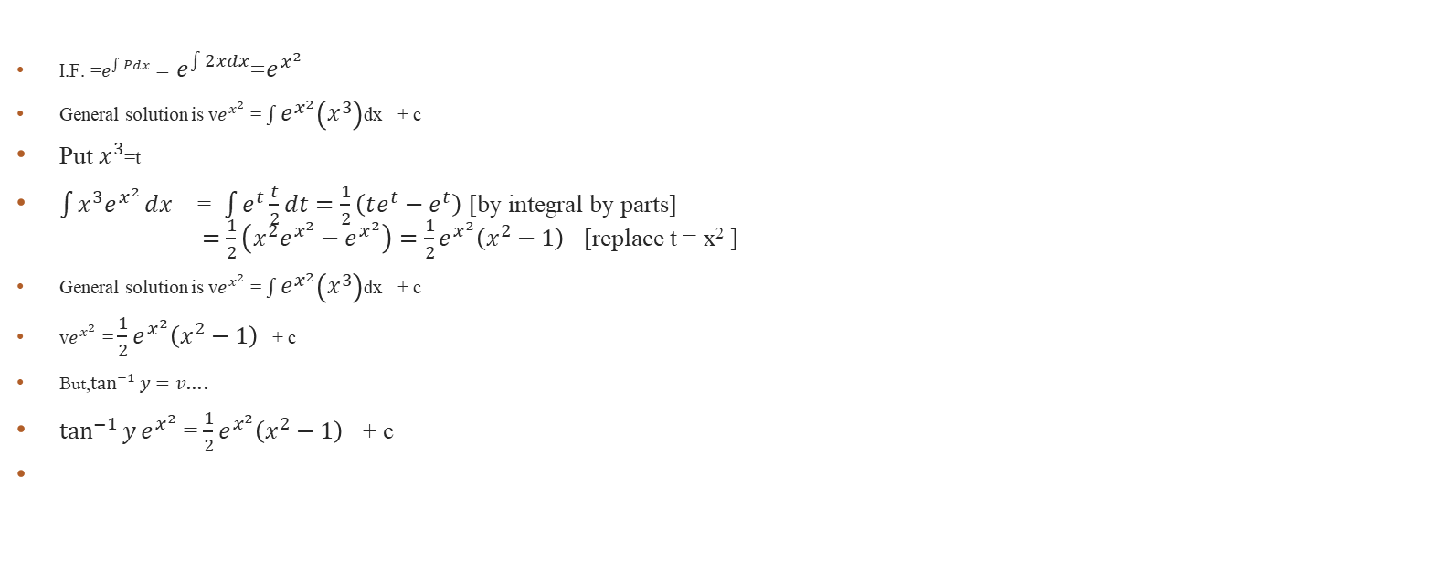

$\frac{dv}{dx}$+2xv= $x^{3}$ $\frac{dy}{dx}+Py=Q$ where P =2x,Q = $x^{3}$
I.F. =$e^{\int{Pdx}}=$ $e^{\int{2xdx}}$=$e^{x^{2}}$
General solution is v$e^{x^{2}}$ = $\int{e^{x^{2}}\left(x^{3}\right)}$dx + c
Put $x^{3}$=t
$\int{x^{3}e^{x^{2}}}dx$ = $\int{e^{t}\frac{t}{2}}dt=\frac{1}{2}\left(te^{t}−e^{t}\right)$ [by integral by parts] $=\frac{1}{2}\left(x^{2}e^{x^{2}}−e^{x^{2}}\right)=\frac{1}{2}e^{x^{2}}\left(x^{2}−1\right)$ [replace t = x² ]
General solution is v$e^{x^{2}}$ = $\int{e^{x^{2}}\left(x^{3}\right)}$dx + c
v$e^{x^{2}}$ = $\frac{1}{2}e^{x^{2}}\left(x^{2}−1\right)$ + c
But,$\tan^{−1}{y=v}$….
$\tan^{−1}{y}e^{x^{2}}$ = $\frac{1}{2}e^{x^{2}}\left(x^{2}−1\right)$ + c

Slide 51
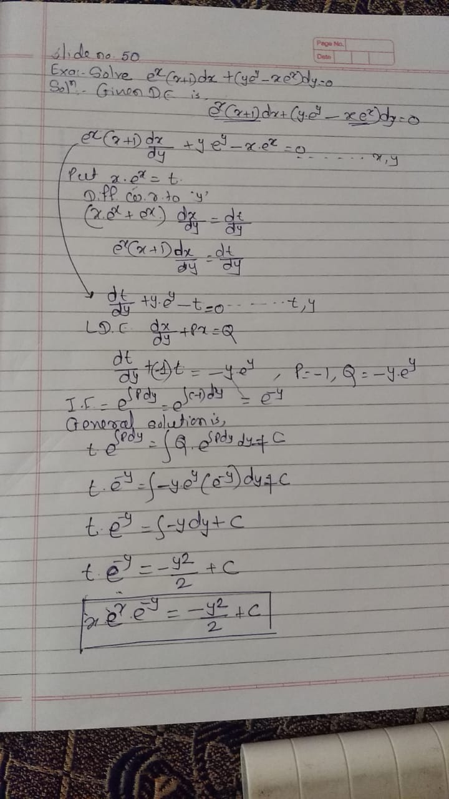
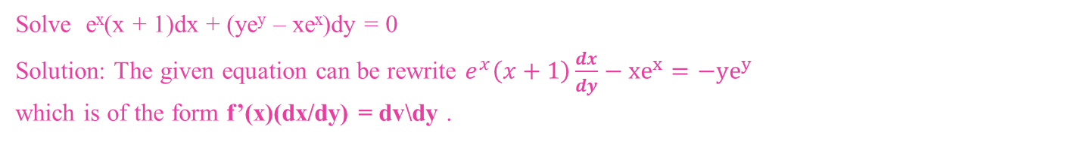
Solve e^{x}(x + 1)dx + (ye^{y} – xe^{x})dy = 0 Solution: The given equation can be rewrite $e^{x}\left(x+1\right)\frac{dx}{dy}−xe^{x}=−ye^{y}$ which is of the form f’(x)(dx/dy) = dv\dy .

Slide 52
Solving Linear D.E.
$\frac{dr}{dθ}+Pr=Q$,
P=P($θ$),Q=Q($θ$)
𝐝𝒓/𝐝𝜽+𝐏𝐫=𝐐,
P=P(𝜽),Q=Q(𝜽)
I.F=$e^{\int{pdθ}}$
I.F=𝒆^∫1▒𝒑𝒅𝜃
General Solution is r$e^{\int{pdθ}}$=$\int{[Q.e^{\int{pdθ}}]dθ+c}$
General Solution is r𝒆^∫1▒𝒑𝒅𝜽=∫1▒〖[𝑸.𝒆^∫1▒𝒑𝒅𝜽]𝒅𝜽+𝒄〗
$\frac{dθ}{dr}+Pr=Q$,
P=P(r),Q=Q(r)
𝐝𝜽/𝐝𝐫+𝐏𝐫=𝐐,
P=P(r),Q=Q(r)
I.F=$e^{\int{pdr}}$
I.F=𝒆^∫1▒𝒑𝒅𝒓
General Solution is $θe^{\int{pdr}}$=$\int{[Q.e^{\int{pdr}}]dr+c}$
General Solution is 𝜽𝒆^∫1▒𝒑𝒅𝒓=∫1▒〖[𝑸.𝒆^∫1▒𝒑𝒅𝒓]𝒅𝒓+𝒄〗
$\frac{dy}{dx}+Py=Q$,
P=P(x),Q=Q(x)
dy/dx+Py=Q,
P=P(x),Q=Q(x)
I.F=$e^{\int{pdx}}$
I.F=𝒆^∫1▒𝒑𝒅𝒙
General Solution is $ye^{\int{pdx}}$=$\int{[Q.e^{\int{pdx}}]dx+c}$
General Solution is 𝒚𝒆^∫1▒𝒑𝒅𝒙=∫1▒〖[𝑸.𝒆^∫1▒𝒑𝒅𝒙]𝒅𝒙+𝒄〗
$\frac{dx}{dy}+Px=Q$,
P=P(y),Q=Q(y)
dx/d𝑦+Px=Q,
P=P(y),Q=Q(y)
I.F=$e^{\int{pdy}}$
I.F=𝒆^∫1▒𝒑𝒅𝒚
General Solution is x$e^{\int{pdy}}$=$\int{[Q.e^{\int{pdy}}]dy+c}$
General Solution is x𝒆^∫1▒𝒑𝒅𝒚=∫1▒〖[𝑸.𝒆^∫1▒𝒑𝒅𝒚]𝒅𝒚+𝒄〗

Slide 53
Solving Bernoulli’s D.E.
$$\frac{dy}{dx}+Py=Qy^{n}$$
𝐝𝐲/𝐝𝐱+𝐏𝐲=𝐐𝐲^𝐧
LDE$\frac{dy}{dx}+Py=Q$
LDE 𝒅𝒚/𝒅𝒙+𝐏𝐲=𝐐
General Solution
$ye^{\int{pdx}}$=$\int{[Q.e^{\int{pdx}}]dx+c}$
General Solution
𝒚𝒆^∫1▒𝒑𝒅𝒙=∫1▒〖[𝑸.𝒆^∫1▒𝒑𝒅𝒙]𝒅𝒙+𝒄〗
$$\frac{dy}{dx}+Py=Qy^{n}$$
𝒅𝒚/𝒅𝒙+𝑷𝒚=𝑸𝒚^𝒏
Divide by $y^{n}$
Divide by 𝐲^𝐧
.
$$\frac{1}{y^{n}}\frac{dy}{dx}+P\frac{1}{y^{n−1}}=Q$$
𝟏/𝒚^𝒏 𝐝𝐲/𝐝𝐱+𝐏 𝟏/𝒚^(𝒏−𝟏) =𝐐
Put $\frac{1}{y^{n−1}}$ = t ,$\frac{1}{y^{n}}\frac{dy}{dx}$ =$\frac{dt}{dx}$
Put 𝟏/𝒚^(𝒏−𝟏) = t ,𝟏/𝒚^𝒏 𝐝𝐲/𝐝𝐱 =𝐝𝒕/𝐝𝐱
$$\frac{dt}{dx}+Pt=Q$$
𝐝𝒕/𝐝𝐱+𝐏𝐭=𝐐
LDE,
$\frac{dt}{dx}+Pt=Q$
LDE,
𝐝𝒕/𝐝𝐱+𝐏𝐭=𝐐
P(x),Q(x)
G.S. is
t.$e^{\int{P dx}}=\int{[Qe^{\int{P}dx}]dx}$
t.𝒆^∫1▒〖𝑷 𝒅𝒙〗=∫1▒〖[𝑸𝒆^(∫1▒𝑷 𝒅𝒙)]𝒅𝒙〗

Slide 54

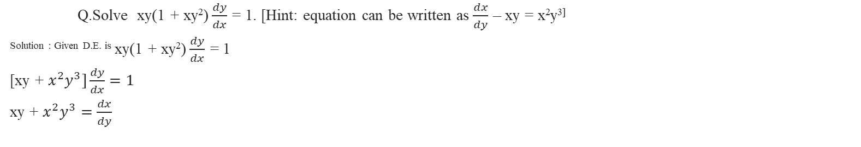
Q.Solve xy(1 + xy²)$\frac{dy}{dx}$ = 1. [Hint: equation can be written as $\frac{dx}{dy}$ – xy = x²y^{3]} ^{Solution : Given D.E. is} xy(1 + xy²)$\frac{dy}{dx}$ = 1 [xy + $x^{2}y^{3}]\frac{dy}{dx}=1$ xy + $x^{2}y^{3}=\frac{dx}{dy}$
$\frac{dx}{dy}$ – xy = x²y3…................................. Bernoulli’s Equation
$\frac{dx}{dy}$ +(-y)x = y³x2-----------------------------P = -y, Q = y³
^{Divide both sides by} x²
$\frac{1}{x^{2}}\frac{dx}{dy}$ +(-y)$\frac{1}{x}$ = y³
^{Put} $\frac{1}{x}$ = t
$\frac{−1}{x^{2}}\frac{dx}{dy}$ = $\frac{dt}{dy}$ …………… $−\frac{dt}{dy}$ –+(-y)$t$= y³
$\frac{dt}{dy}$ +(y)$t$= -y^{3………………………………..LDE}

Slide 55
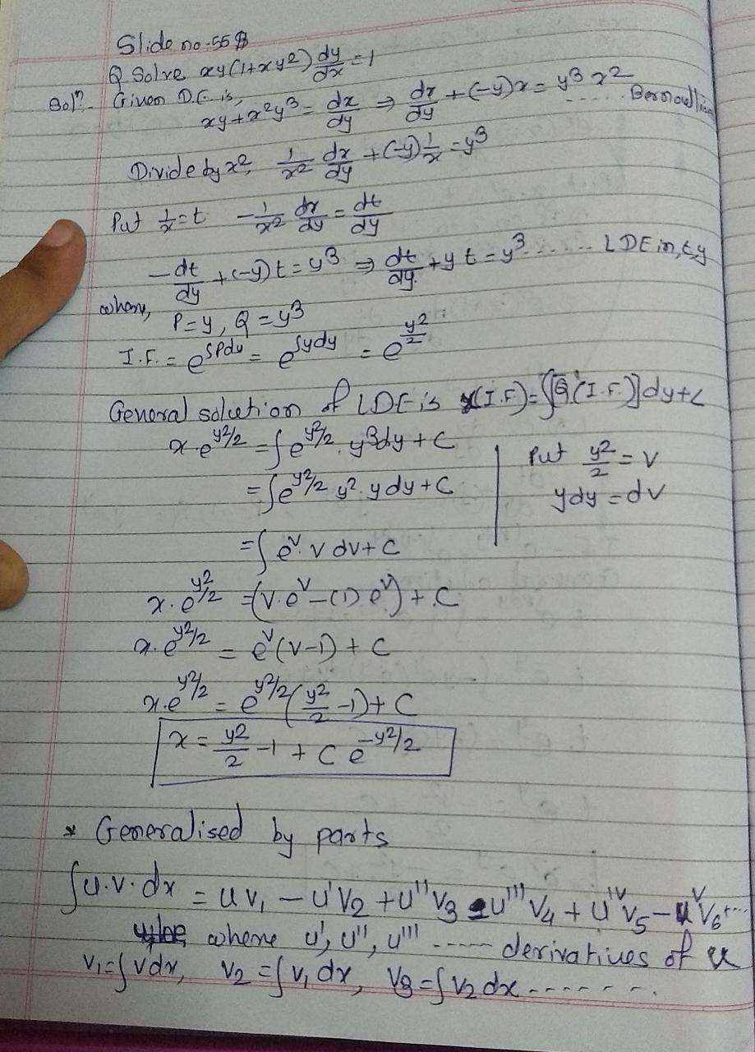

Slide 56


Q.Solve $\frac{dr}{dθ}=r\tan{θ−\frac{r^{2}}{\cos{θ}}}$ [OR] $\frac{dr}{dθ}=\frac{r\sin{θ}−r^{2}}{\cos{θ}}$ Solution : Given D.E. is $\frac{dr}{dθ}=\frac{r\sin{θ}−r^{2}}{\cos{θ}}$ $\frac{dr}{dθ}=r\tan{θ−\frac{r^{2}}{\cos{θ}}}$ $\frac{dr}{dθ}−r\tan{θ=−\frac{r^{2}}{\cos{θ}}}$
$\frac{dr}{dθ}+(−\tan{θ)r=−\frac{1}{\cos{θ}}}r^{2}$------------ Bernoulli’s Equation in r $,{θ}$
Divide by 1/ $r^{2}$
$\frac{dr}{r^{2}dθ}+(−\tan{θ)\frac{1}{r}=−\frac{1}{\cos{θ}}}$
Put 1/r =t, $\frac{−dr}{r^{2}dθ}$= $\frac{dt}{dθ}$
$\frac{−dt}{dθ}+(−\tan{θ)t =−\frac{1}{\cos{θ}}}$
$\frac{dt}{dθ}+(\tan{θ)t =\frac{1}{\cos{θ}}}$…………..LDE in t $,{θ}$

Slide 57


Slide 58


Bernoulli’s Equation : Type I:The equation of the form $\frac{dy}{dx}+Py=Qy^{n}$where P and Q are functions of x only is called Bernoulli’s equation and is reducible to linear form by dividing by $y^{n} and putting \frac{1}{y^{n−1}}$ = v it can be solved
Example 1: Solve $\frac{dy}{dx}=x^{3}y^{3}−xy$
Solution: Step I: Given equation can be rewritten as $\frac{dy}{dx}{+xy=x}^{3}y^{3}$ …….(A) which is of the form $\frac{dy}{dx}+Py=Qy^{n}$
Divided the equation (A) by $y^{3}$, $\frac{1}{y^{3}}\frac{dy}{dx}{+\frac{1}{y^{2}}x=x}^{3}$ ………….(B)
put $\frac{1}{y^{2}}$ = v ∴ $−\frac{2}{y^{3}}\frac{dy}{dx}=\frac{dv}{dx}∴\frac{1}{y^{3}}\frac{dy}{dx}=−\frac{1}{2}\frac{dv}{dx}$
Equation (B) can be written as $−\frac{1}{2}\frac{dv}{dx}$ + vx = x³
∴ $\frac{dv}{dx}$ – 2vx = -2x³ which is of the form
$\frac{dy}{dx}$+Py = Q linear equation.

Slide 59


$\frac{dv}{dx}$ – 2vx = -2x³ $\frac{dv}{dx}$+( – 2x)v = -2x³
Step II here P =-2x and Q = -2x³
∴$e^{\int{pdx}}=e^{\int{−2xdx}}=e^{−x^{2}}$
∴ The Solution is v$e^{−x^{2}}$ = $\int{−2x^{3}}\left(e^{−x^{2}}\right)dx=c$
put x² = t 2xdx = dt. Xdx = dt/2
∴ v$e^{−x^{2}}$= $\int{−t}\left(e^{−t}\right)dt+c=te^{−t}+e^{−t}+c$
$=x^{2}e^{−x^{2}}+e^{−x^{2}}+c$ [put t = x²]
Put v = $\frac{1}{y^{2}}$ , general solution is $\frac{1}{y^{2}}e^{−x^{2}}=x^{2}e^{−x^{2}}+e^{−x^{2}}+c$
$∴\frac{1}{y^{2}}=x^{2}+1+ce^{x^{2}}$

Slide 60


Q.Solve x dy/dx + y = x³y⁶ Solution: Step I given equation can be written as $\frac{1}{y^{6}}\frac{dy}{dx}+\frac{1}{y^{5}}\frac{1}{x}=x^{2}$ [divide the equation by x and divide by y⁶]
Put, $\frac{1}{y^{5}}$=t
$\frac{−5}{y^{6}}\frac{dy}{dx}$= $\frac{dt}{dx}$
$\frac{dt}{dx(−5)}+\frac{1}{x}t=x^{2}$
$\frac{dt}{dx}+\frac{(−5)}{x}t={(−5)x}^{2−−−−−−−−−−−−−−−−−−−LDE }$ P= $\frac{−5}{x}$ ,Q= ${−5x}^{2 }$,I.F =$e^{\int{pdx}}=e^{\int{−5/xdx}}=e^{−5logx}=x^{−5}$
∴ The Solution is t. $x^{−5}$ = $\int{{(−5)x}^{2 }}\left(x^{−5} \right)dx+c$
t$x^{−5}$ =$\int{{(−5)x}^{−3 }}+c$
$\frac{1}{y^{5}x^{5}}$=$\frac{5}{2x^{2}}+c$

